Slide 1
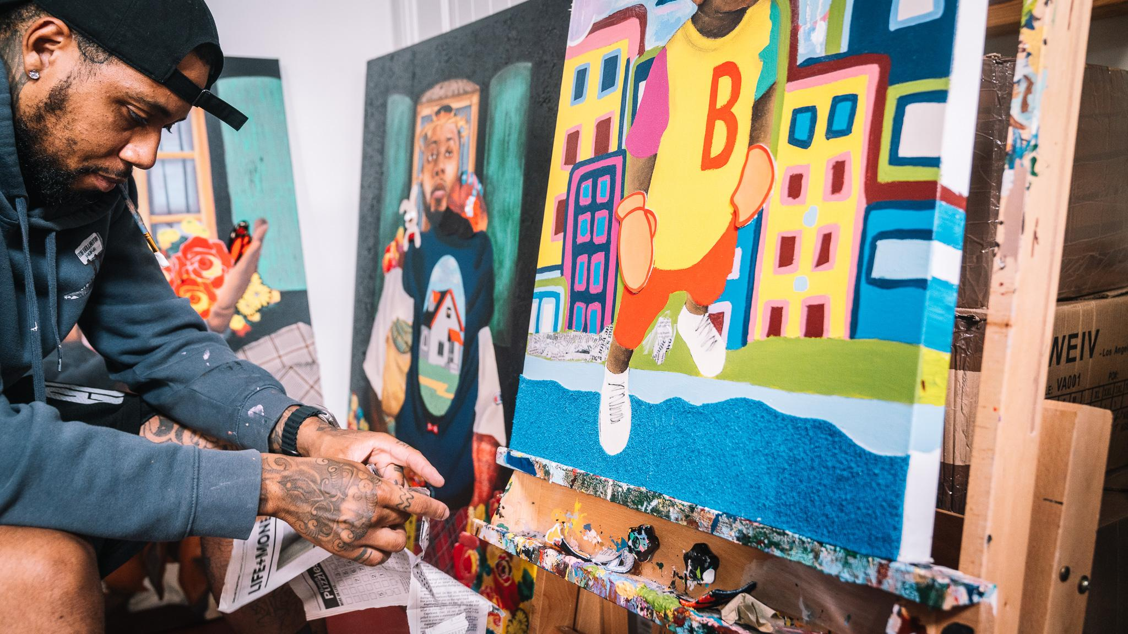
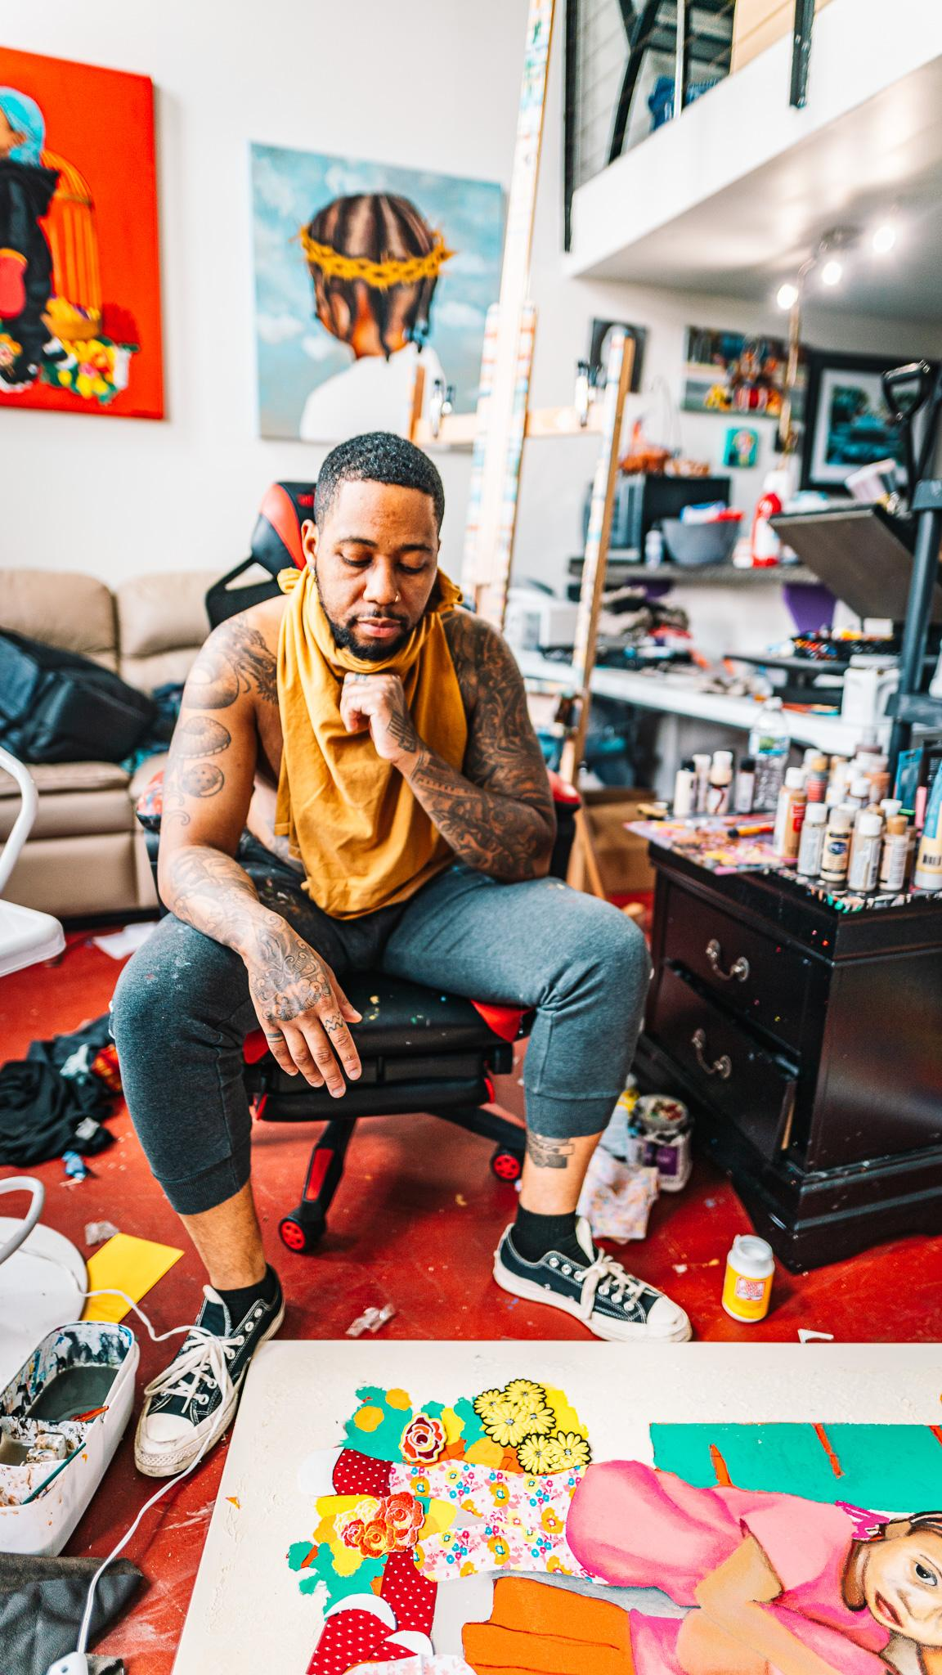
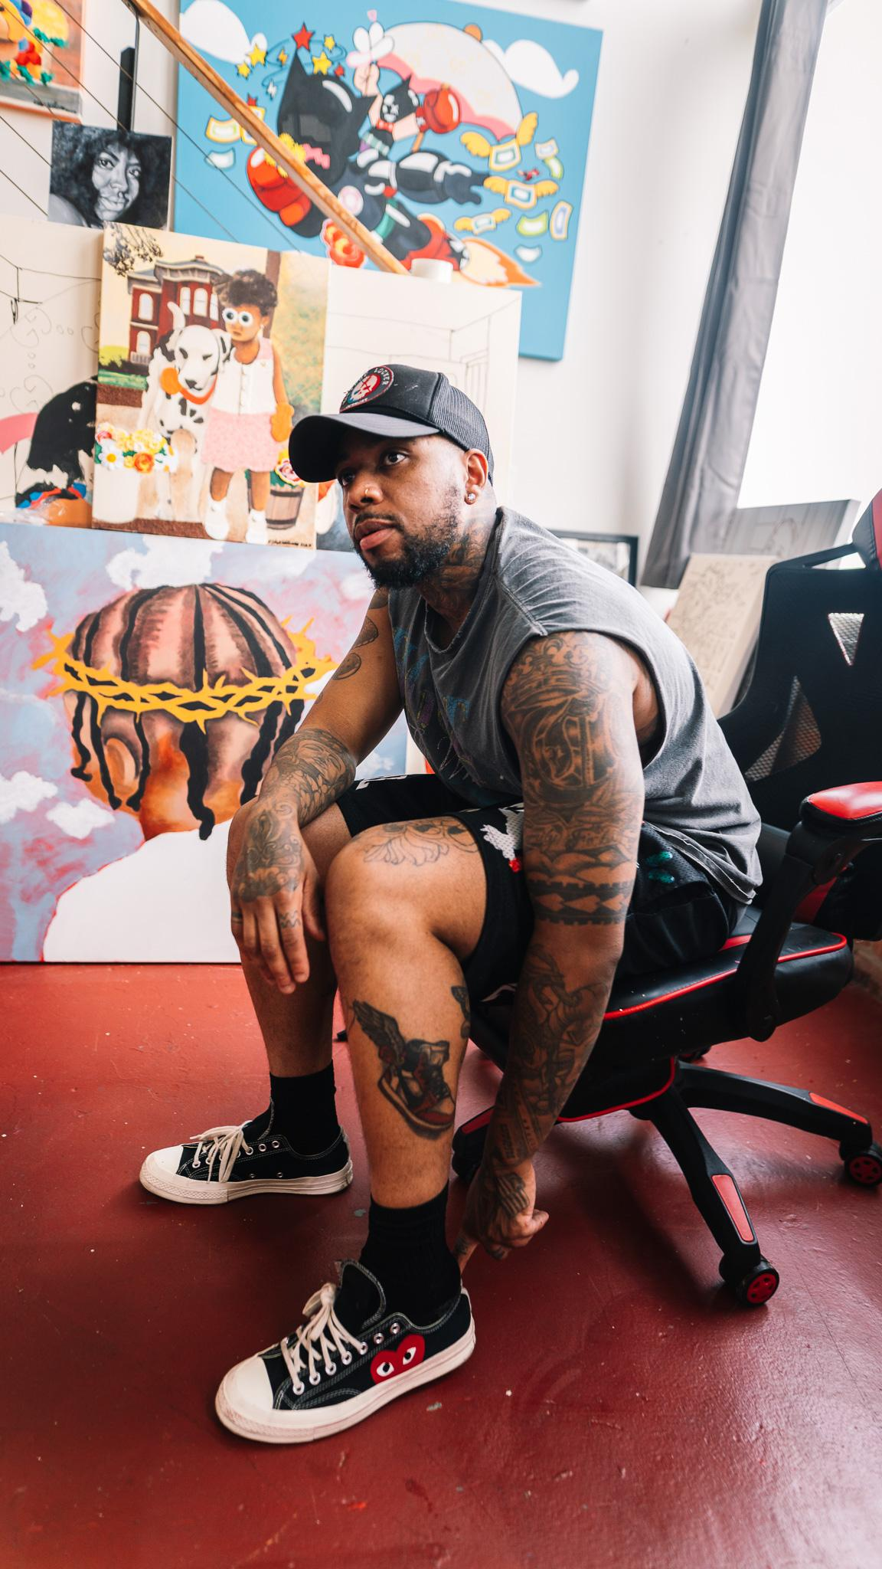
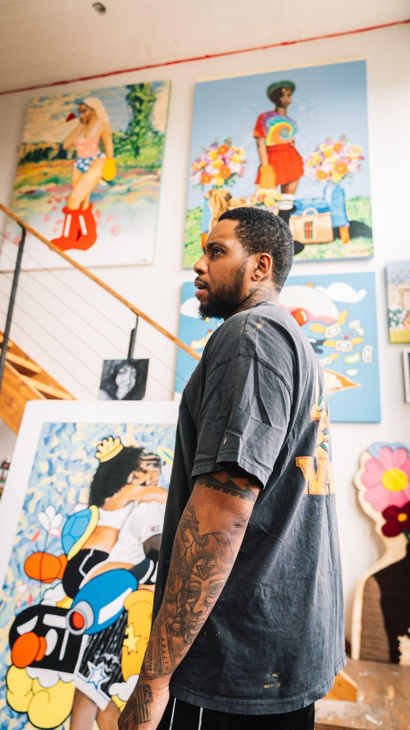
O S H U N W I L L I A M S

Slide 2
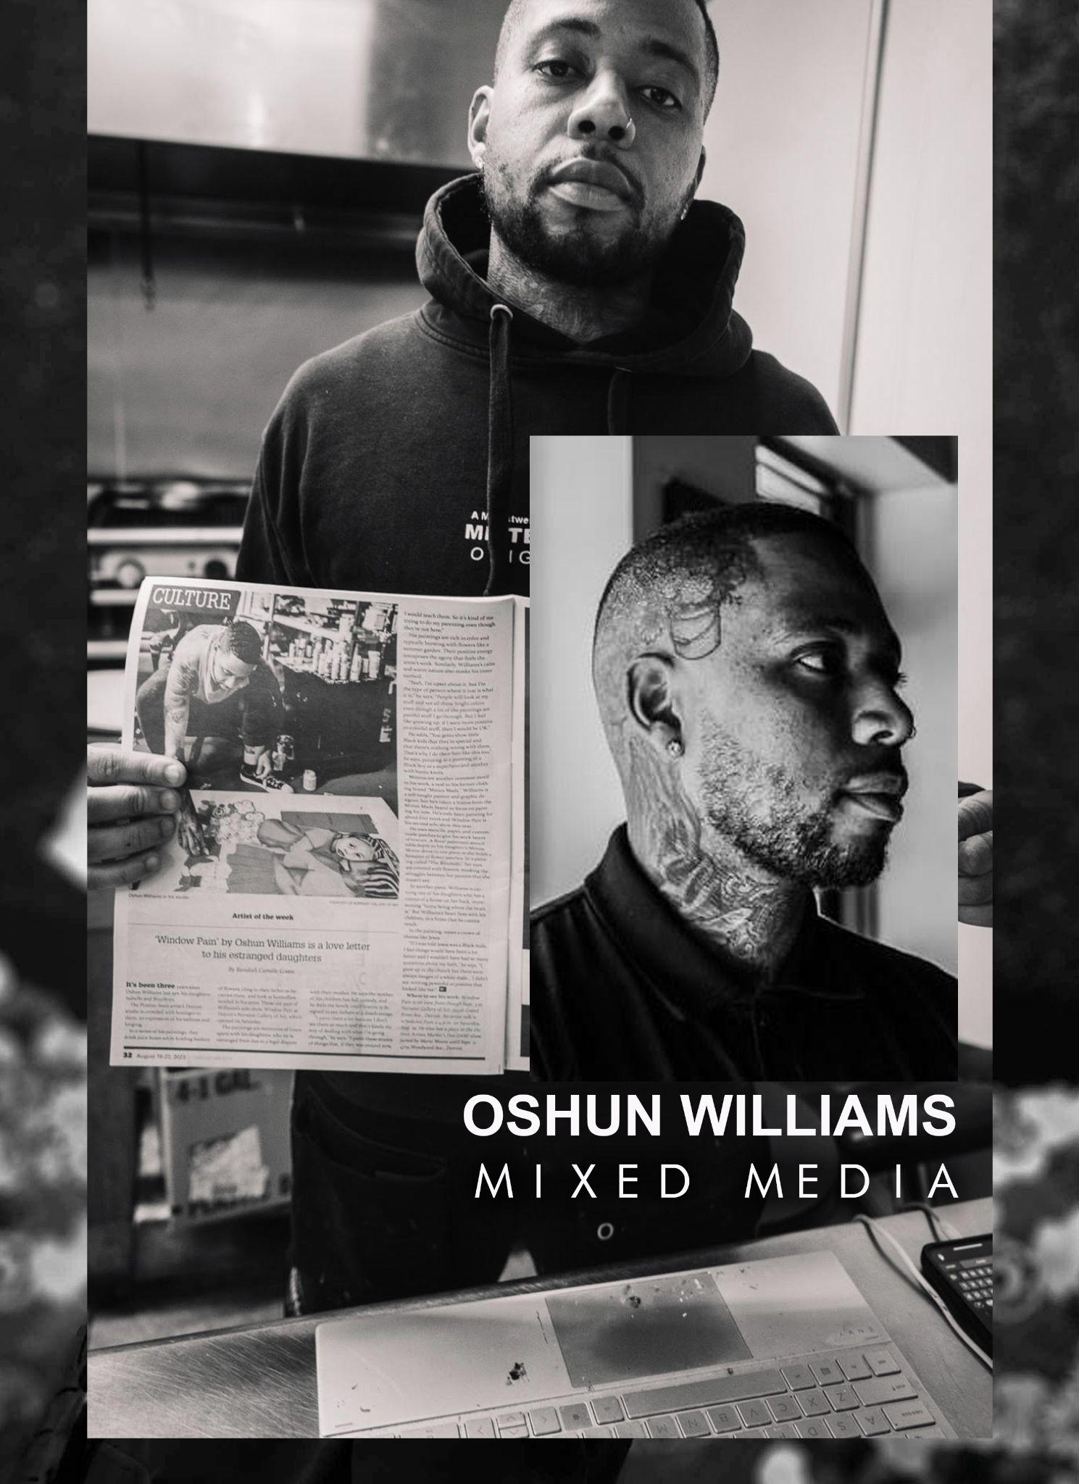
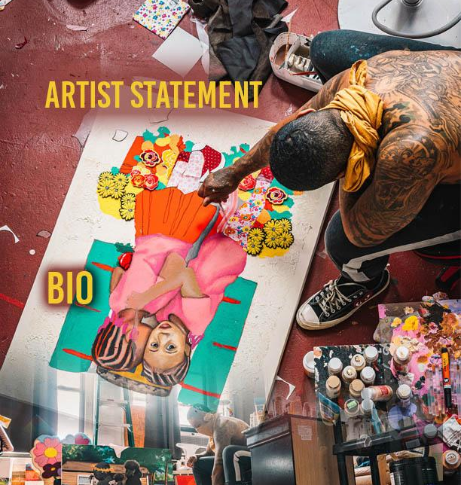
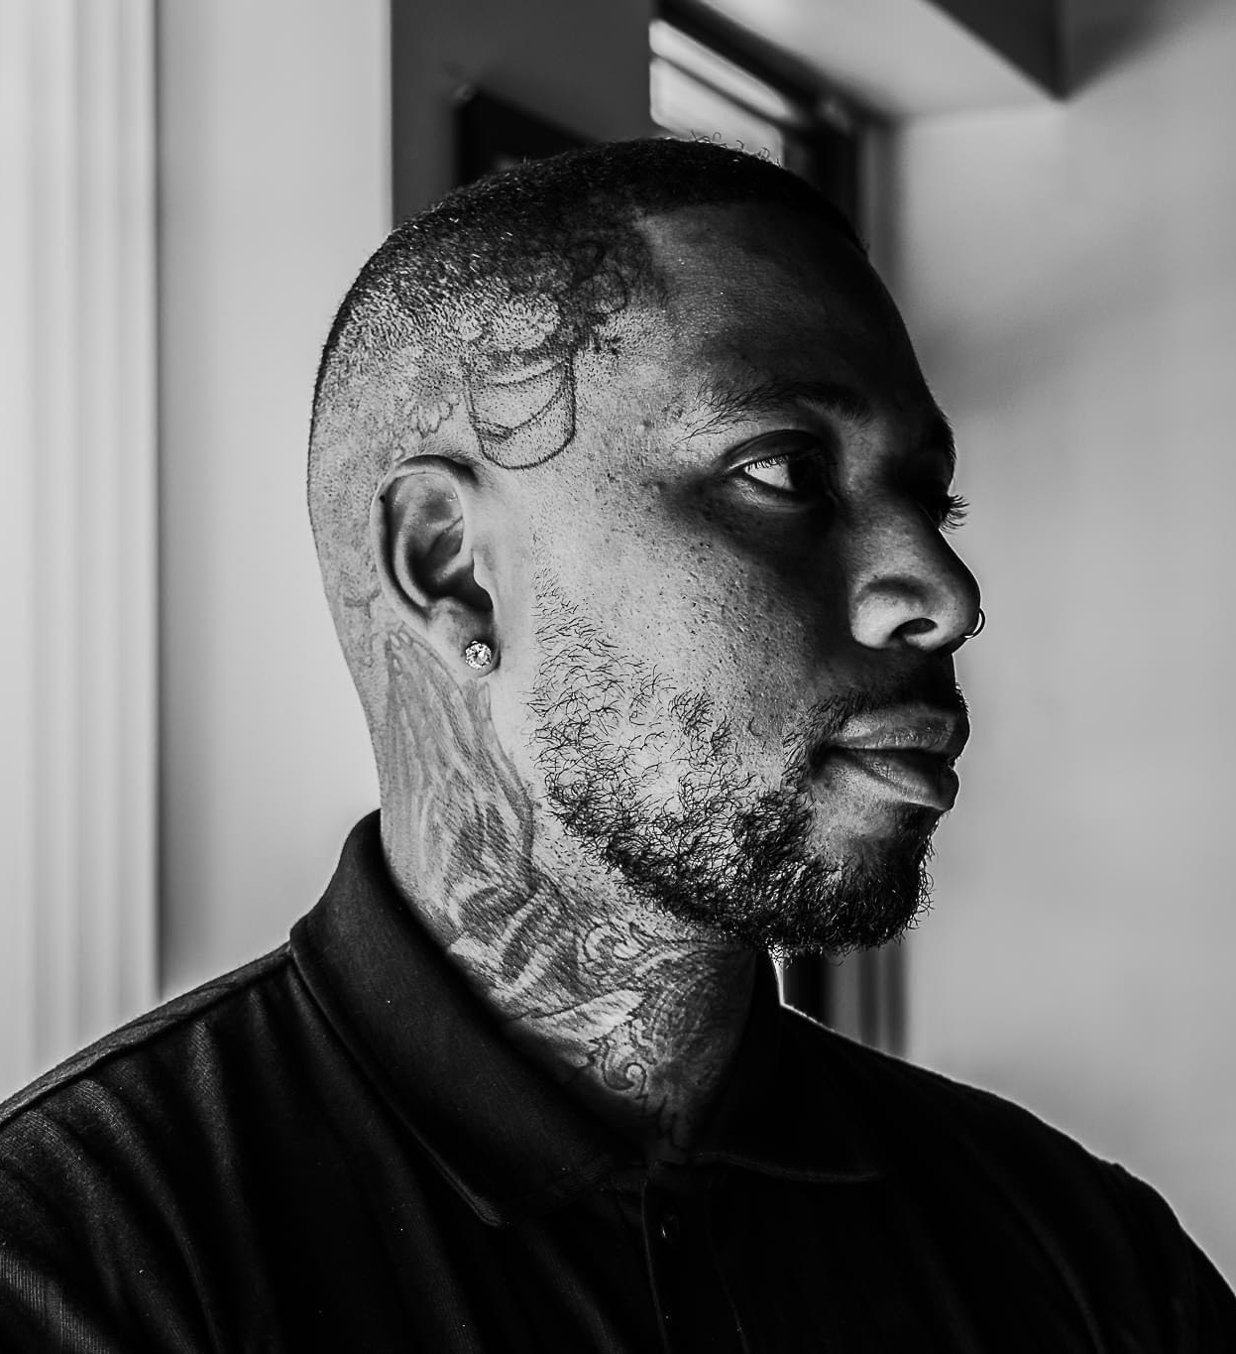
When I create art, It provides me with an appreciation of fulfillment. It grants me a sense of purpose. A life without purpose has no meaning. My ambition is to captivate the comprehension of others by composing distinguished works of arts. I generate art by applying acrylic on canvas. I use different mediums such as chenille patches, fabrics, and newspapers to bring diversity into my paintings. Being from the mitten shaped state I apply mittens in my paintings to remind individuals to always commit to conventional actions and not misleading discord.
Named after the popular Yoruba goddess, OShun Williams was born and raised in Pontiac, MI. He is a self-taught emerging artist rapidly flourishing in the Metro-Detroit arts community. Known for his unique complementary style, Williams applies his own chenille patches to his works of art to add a mixed media touch to his pieces. He paints with acrylic on canvas and occasionally uses newspaper to perceive texture throughout his pieces. He is a dedicated father who admires painting gratifying images of his two beloved daughters. Williams states that he paints to generate as many assets as possible to create a legacy to his children because of his strong belief in sustaining generational wealth.

Slide 3
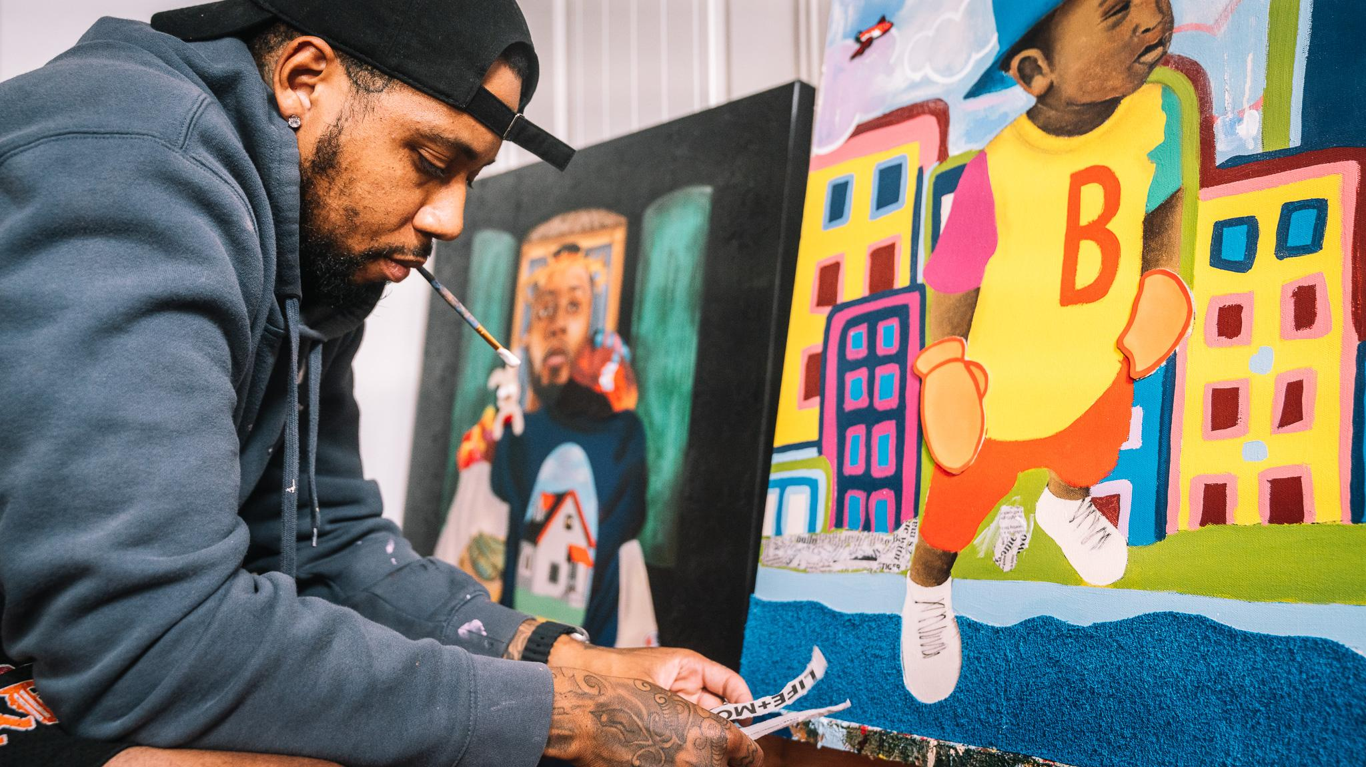
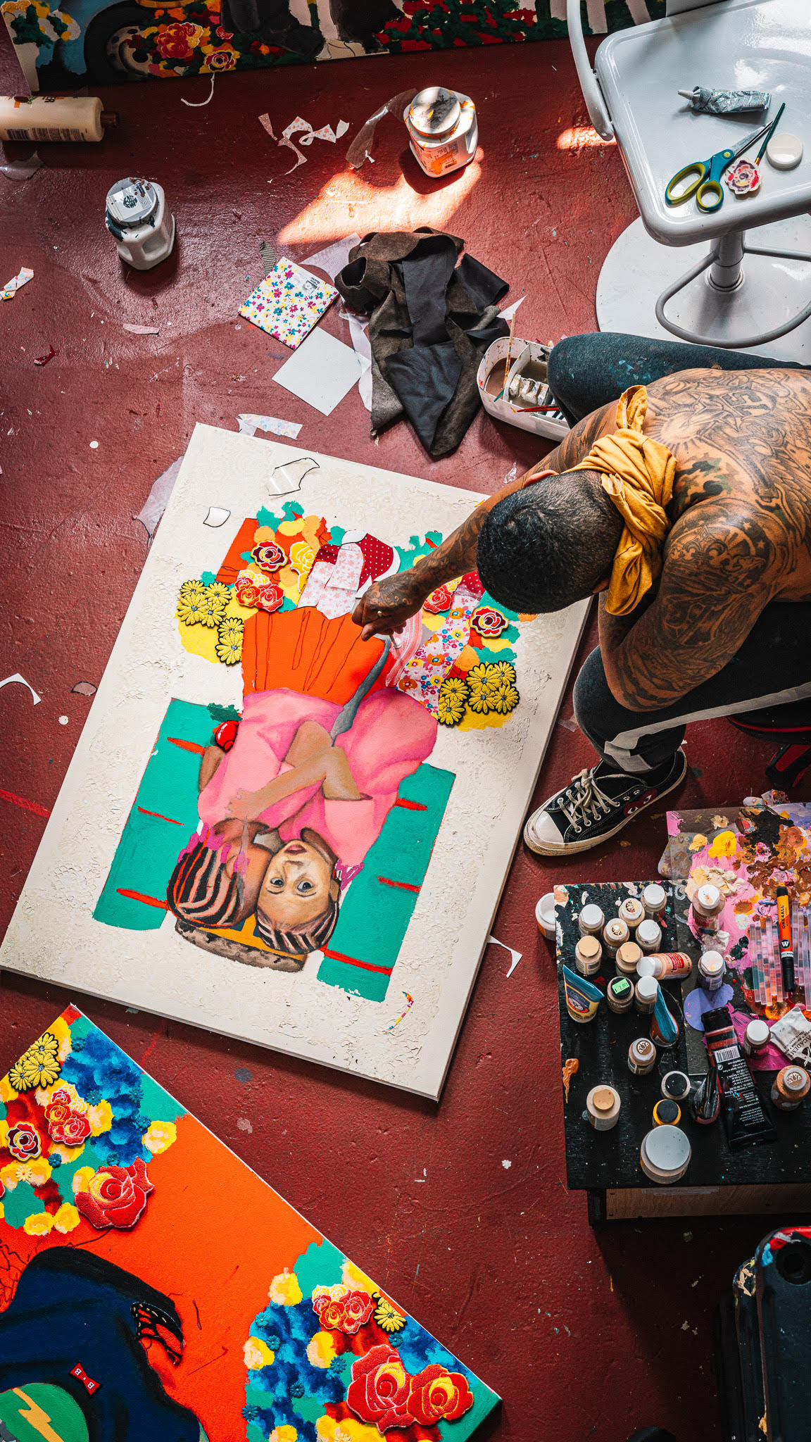
Emerging Artist, Oshun Williams, has been climbing tremendously through the Detroit art market with his innovative mixed media pieces.

Slide 4
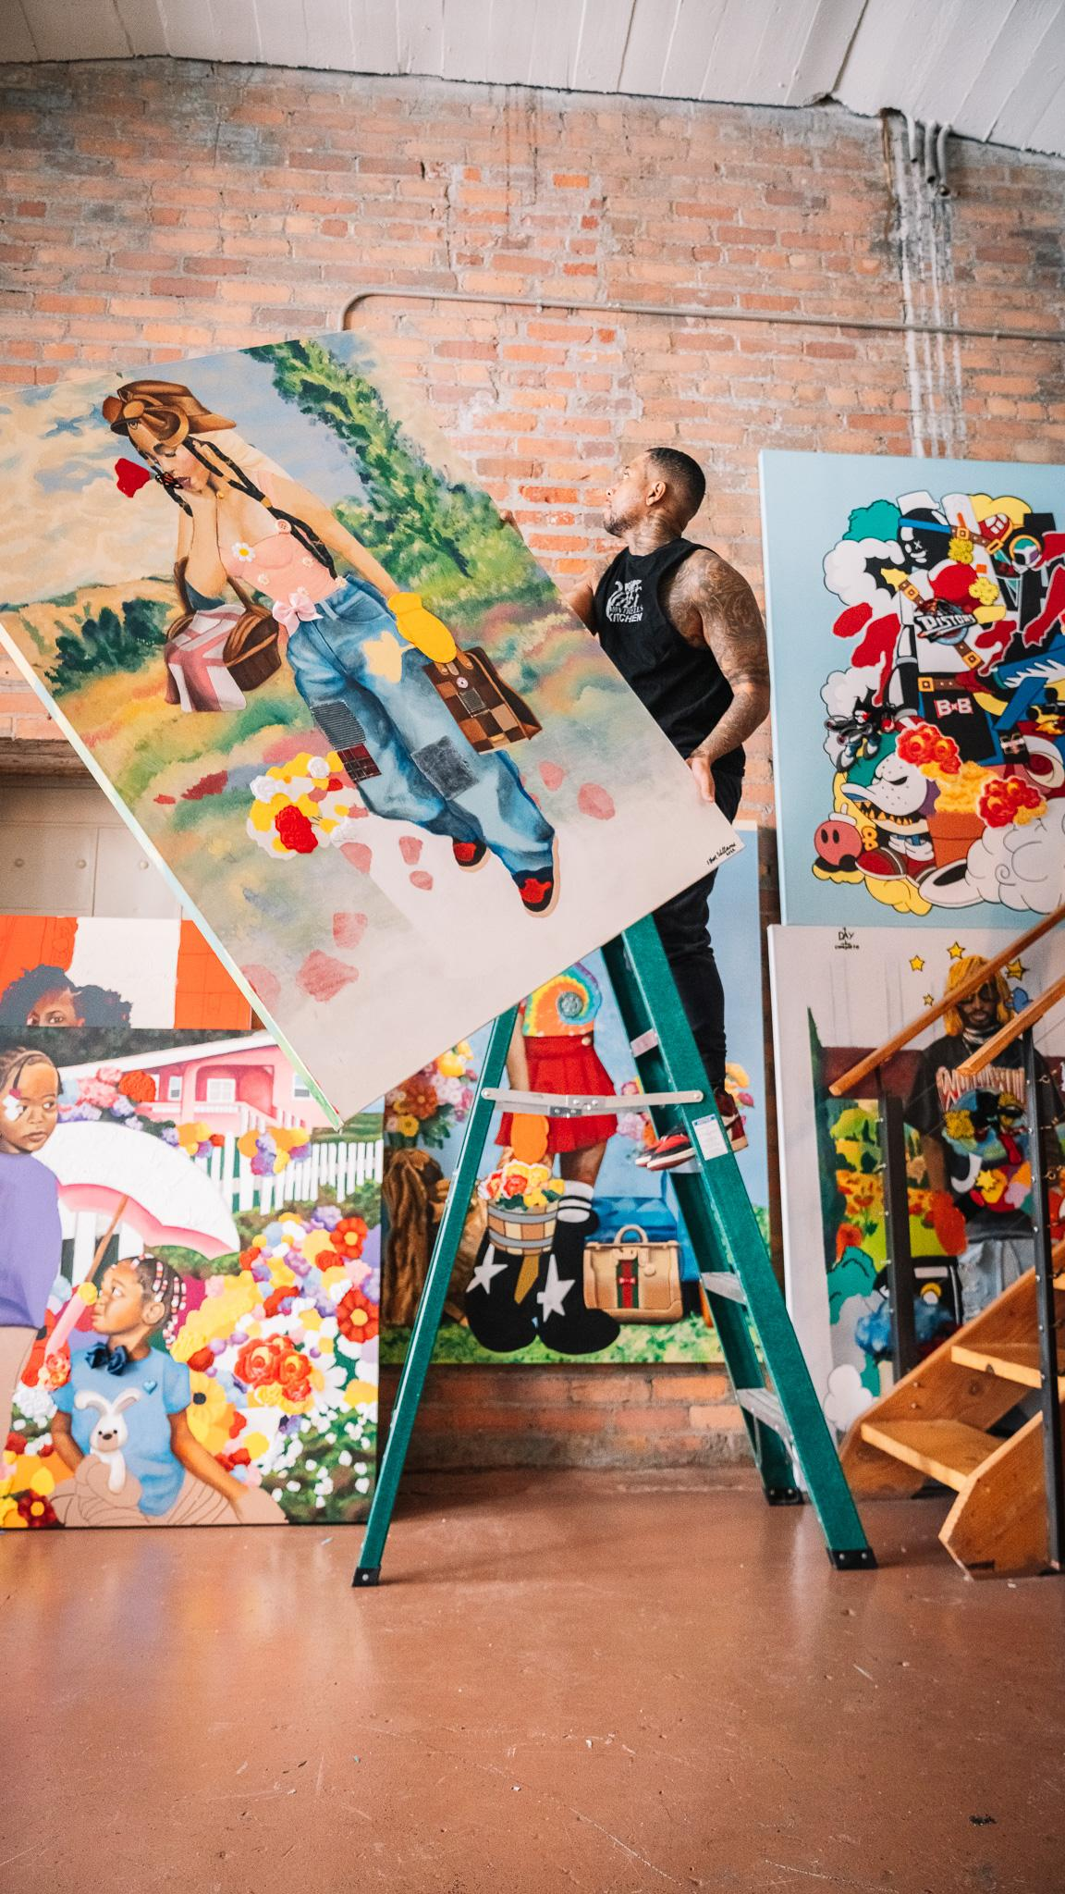
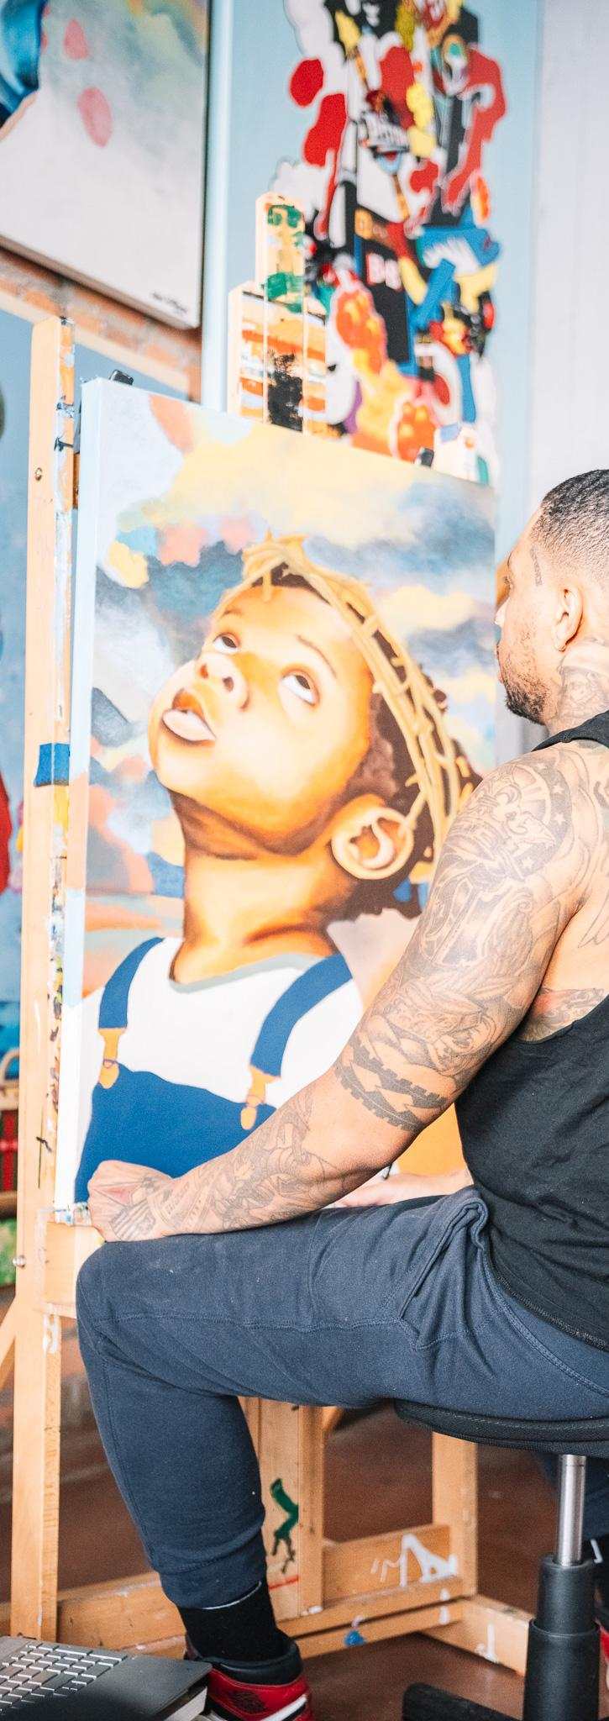
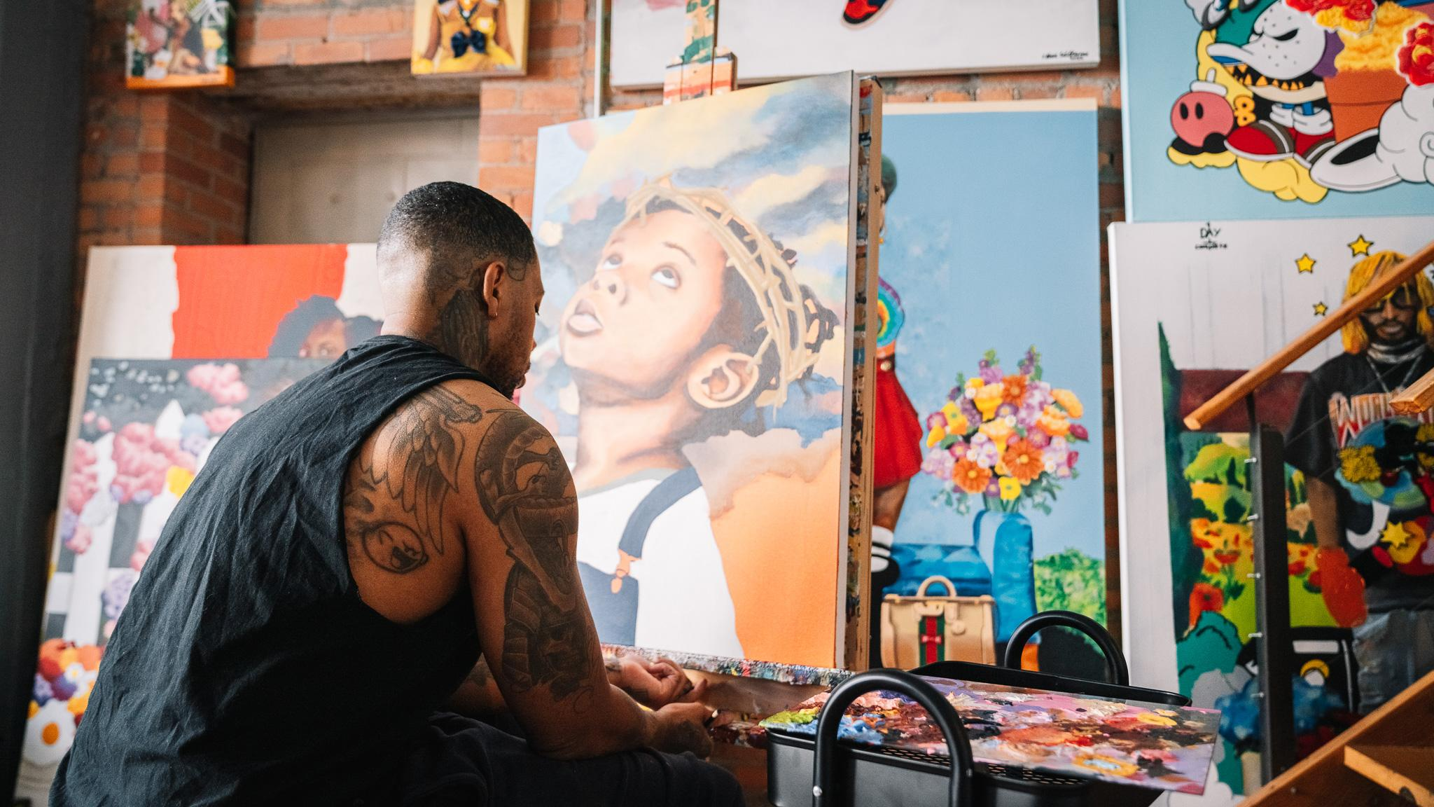
STUDIO

Slide 5
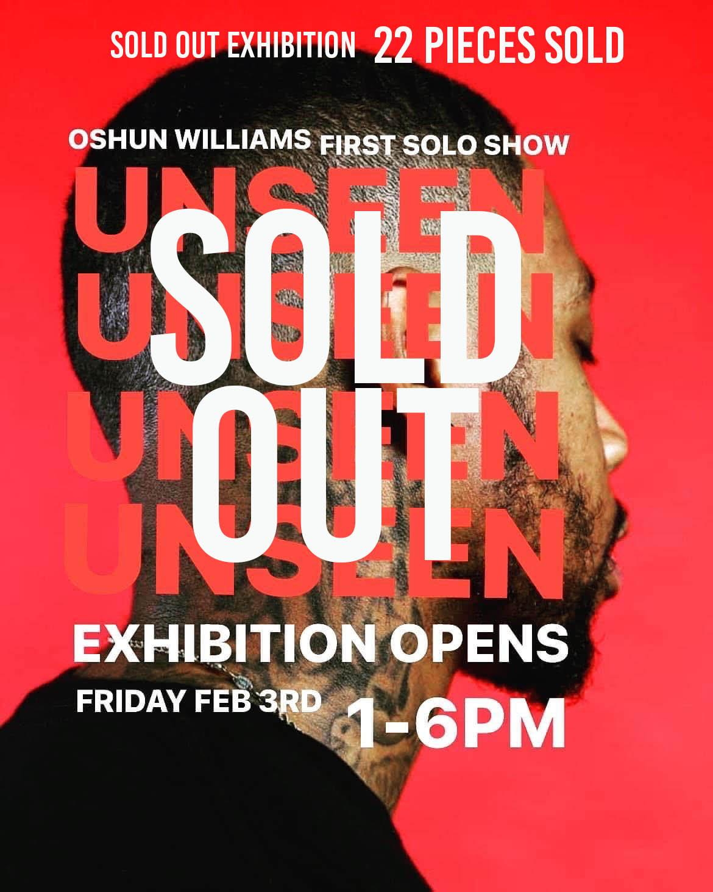
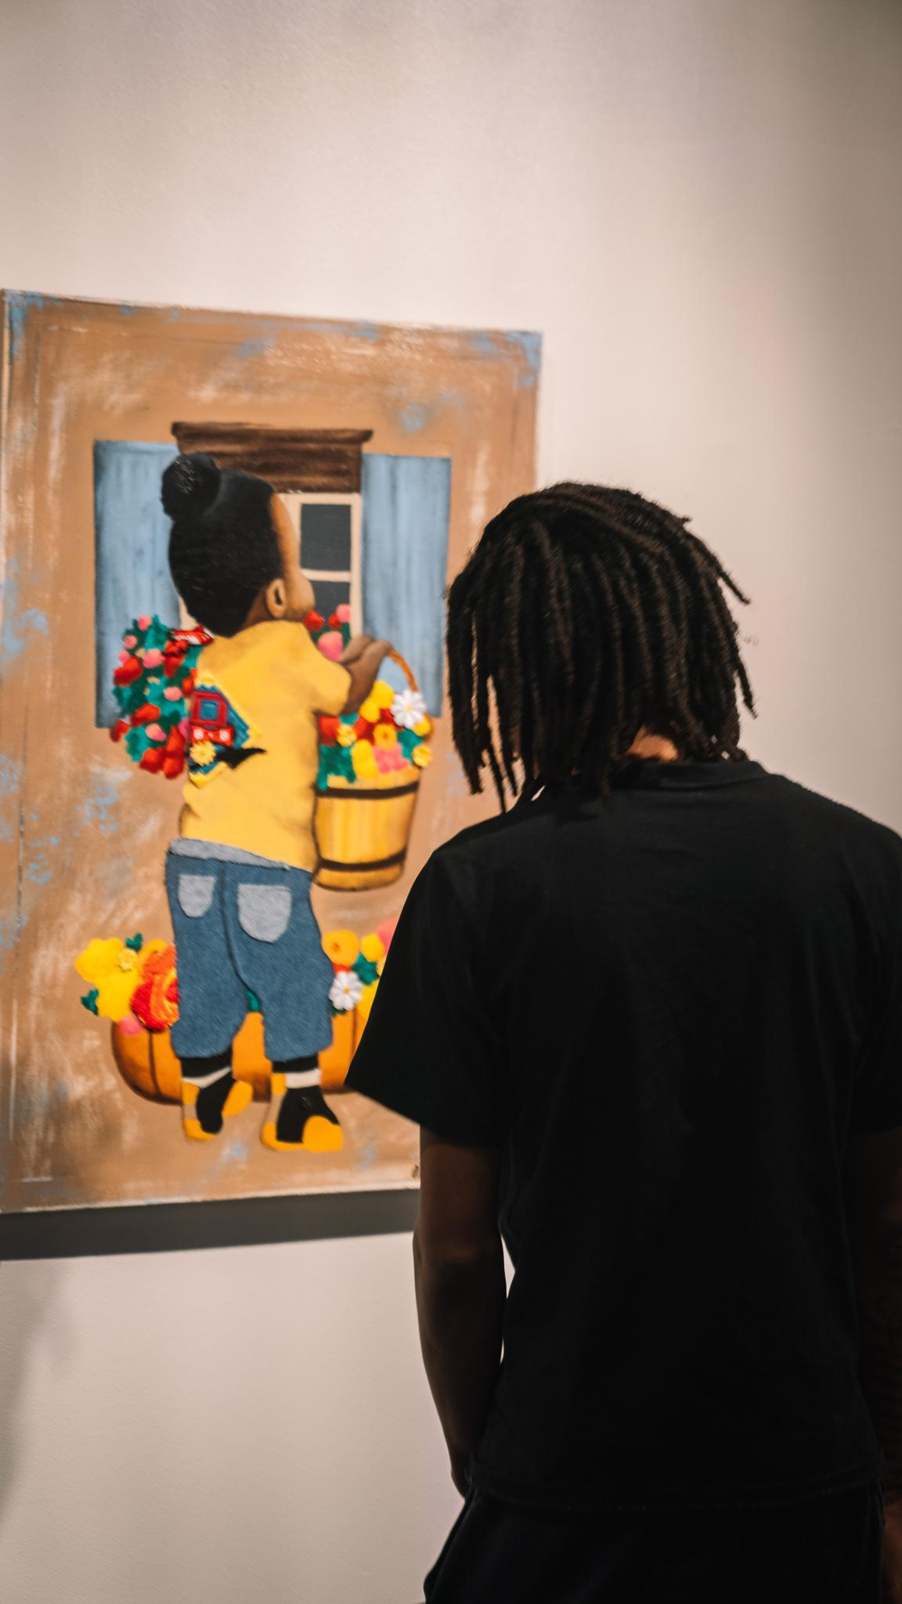
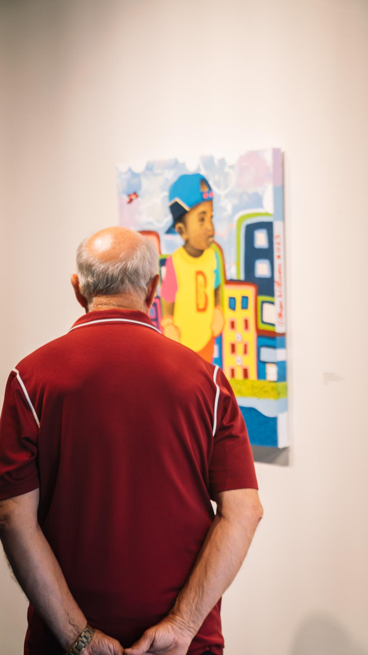
1st SOLO EXHIBITION
SOLD OUT At Harper’s Galleries & Interiors
FEBRUARY 2023

Slide 6
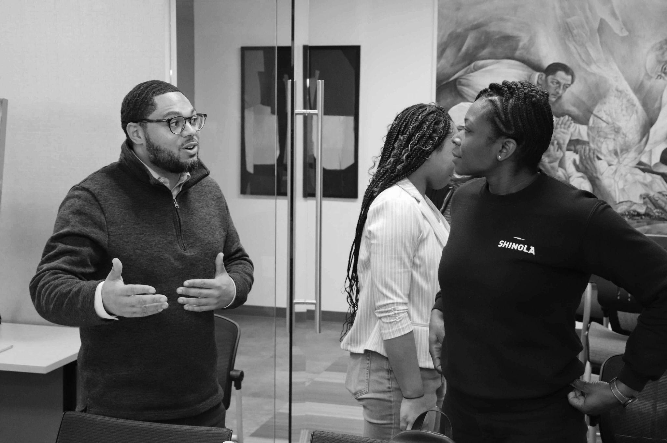
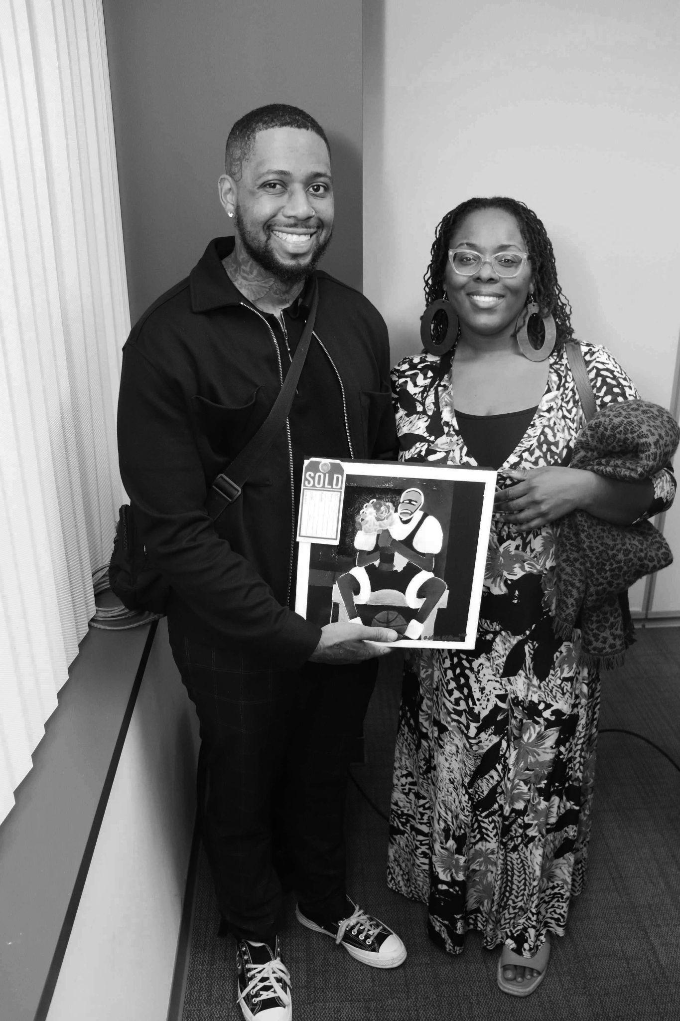
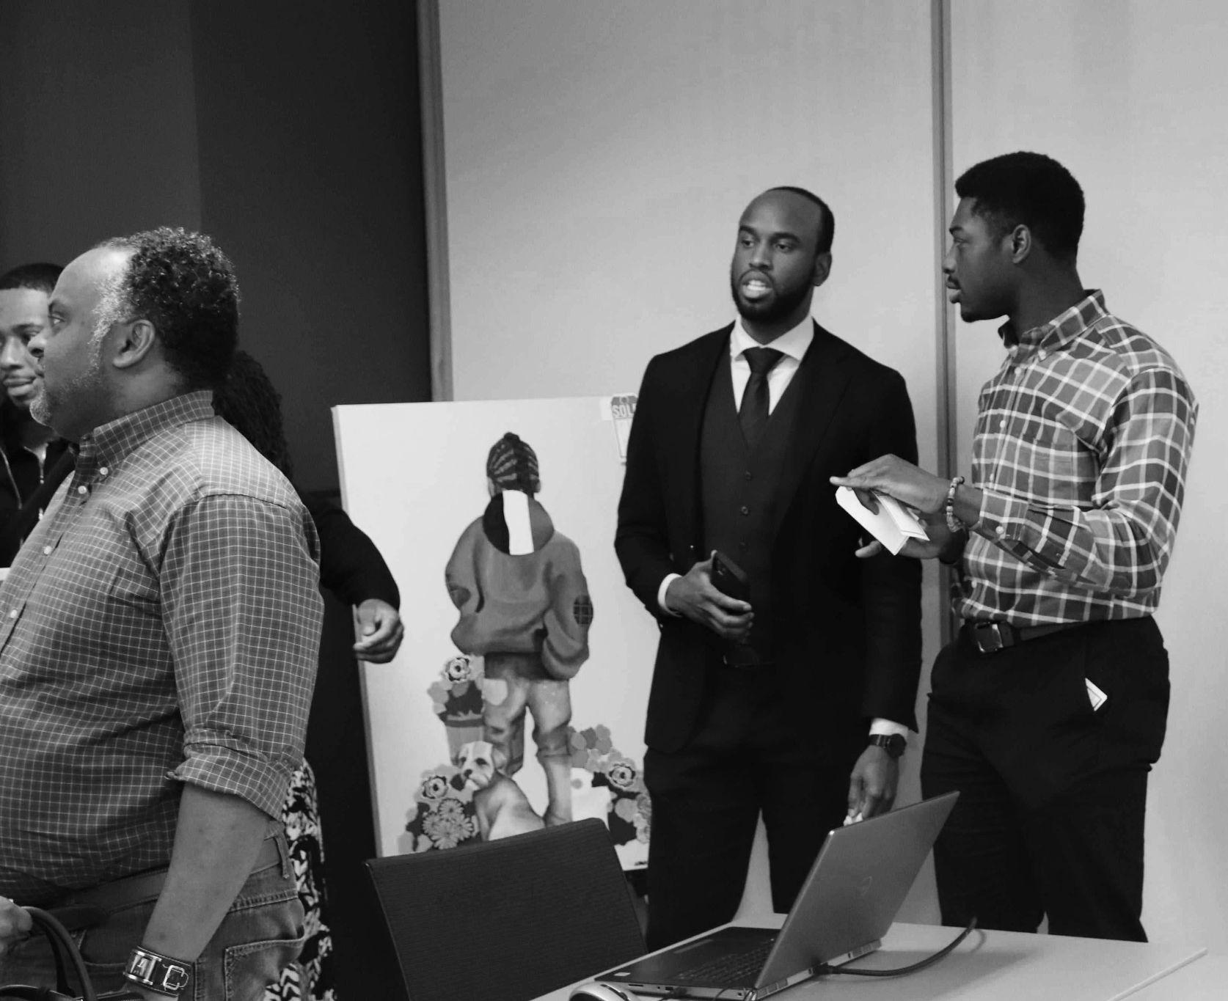
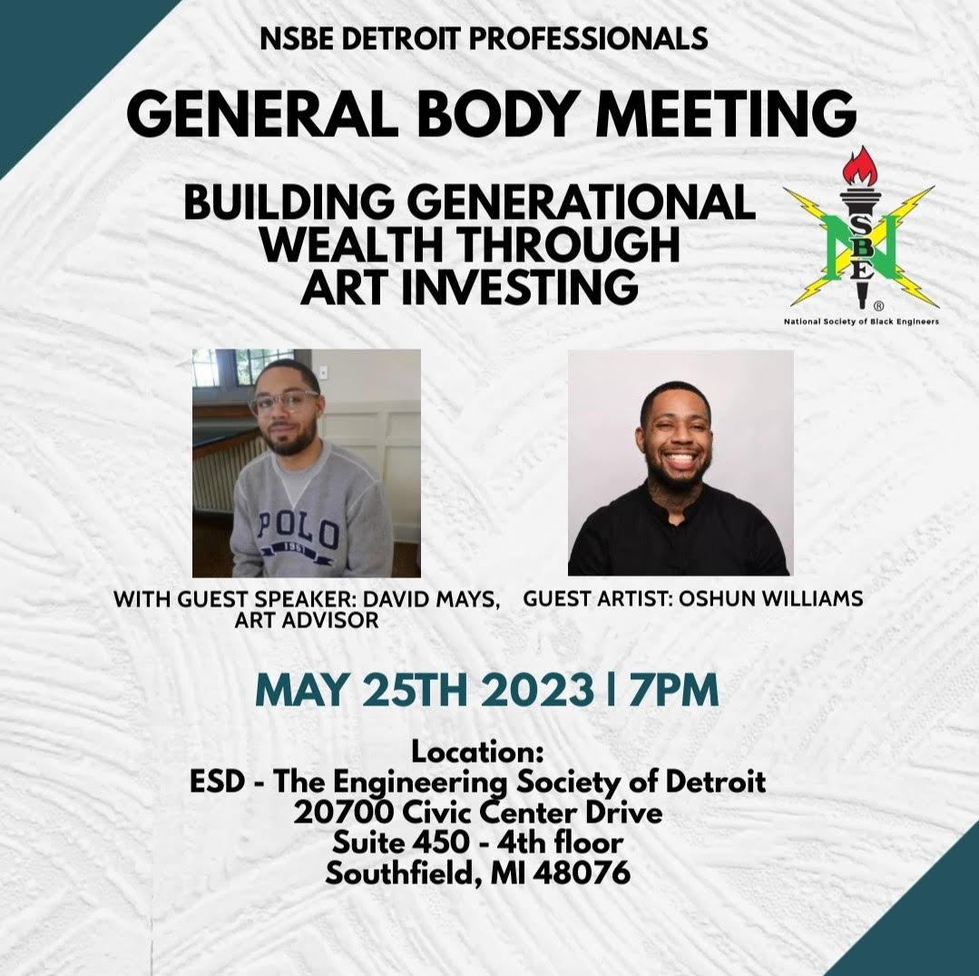
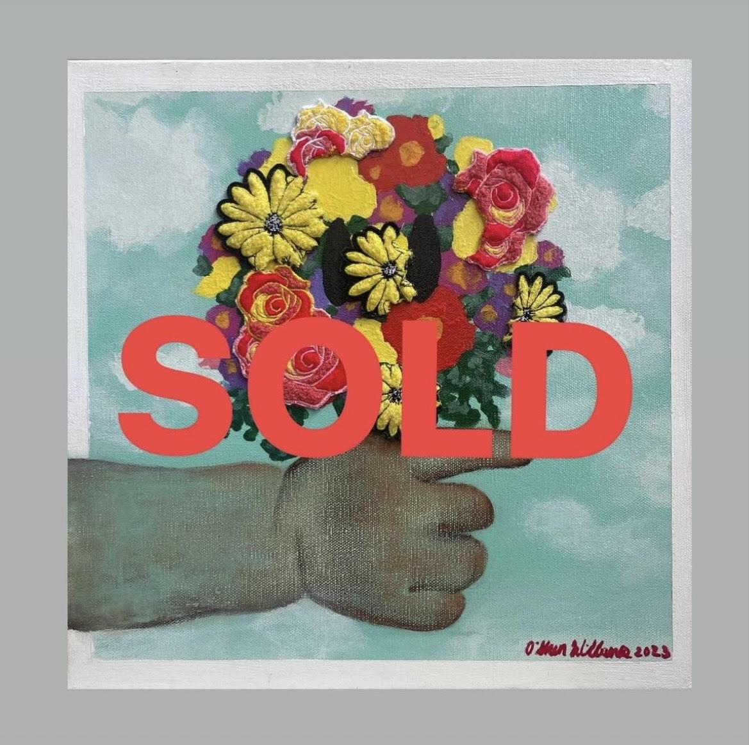
MAY 2023
SOLD OUT

Slide 7
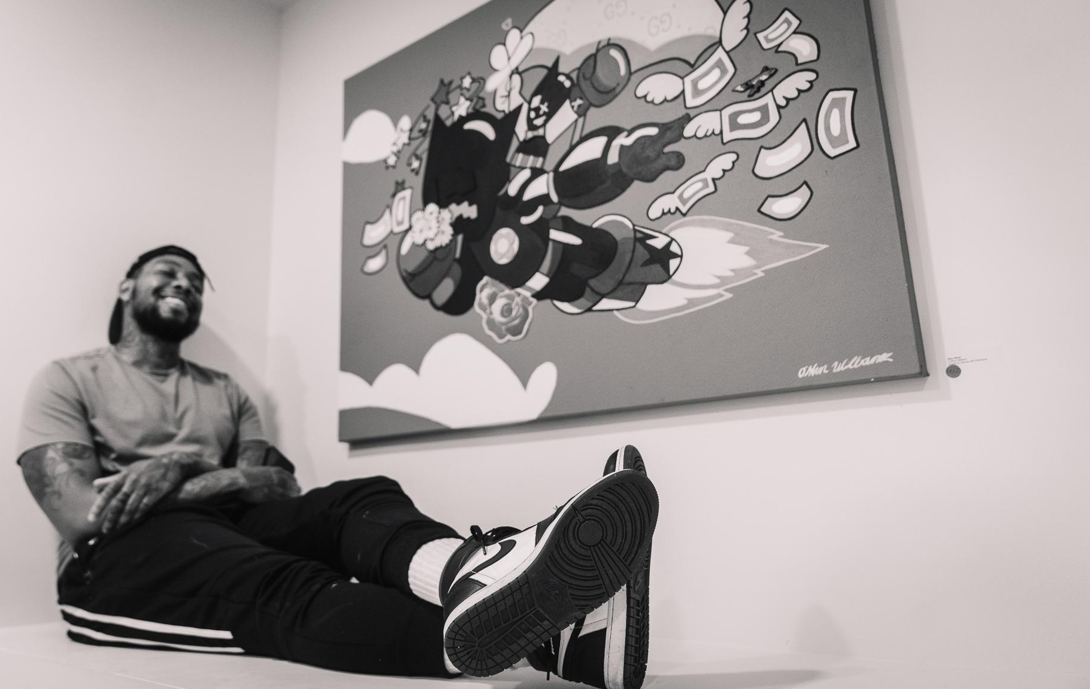
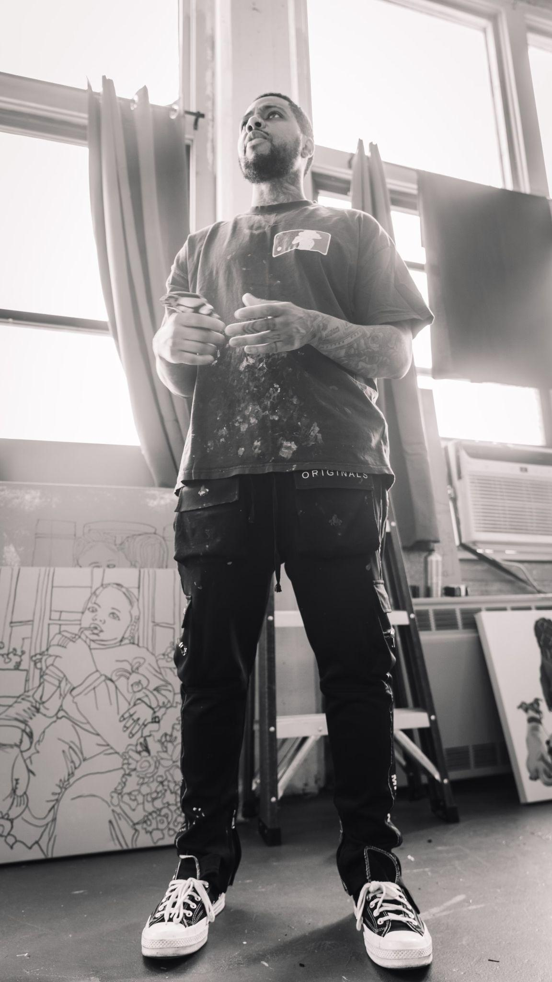
JUNE 2023
SOLD OUT
GROUP EXHIBITION

Slide 8
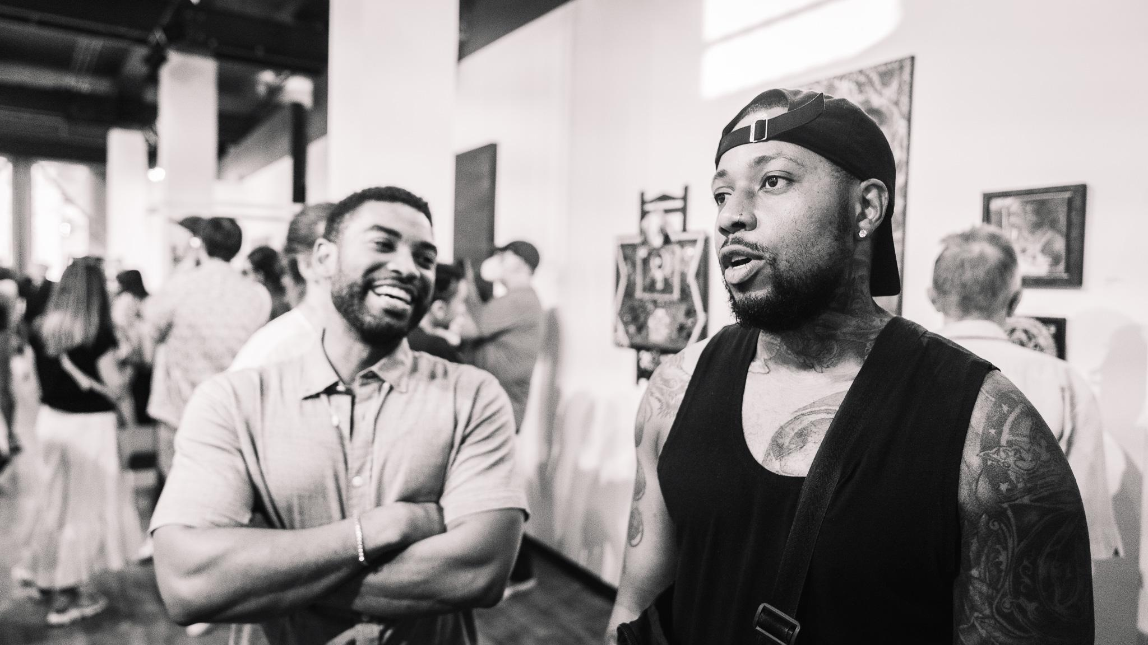
GROUP EXHIBITION
2023

Slide 9
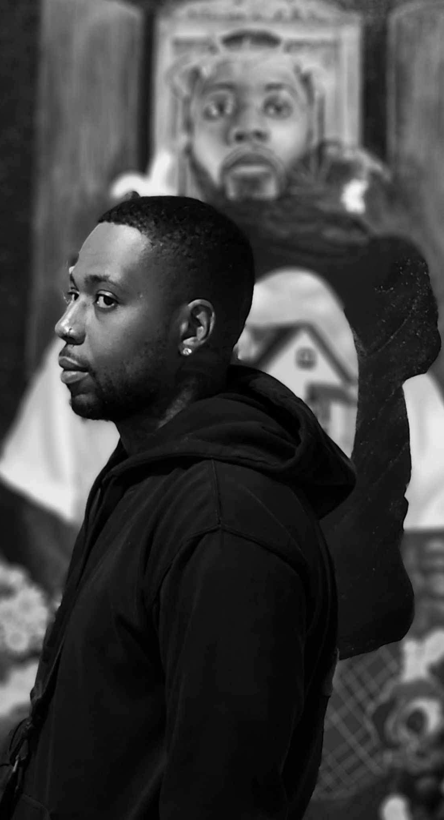
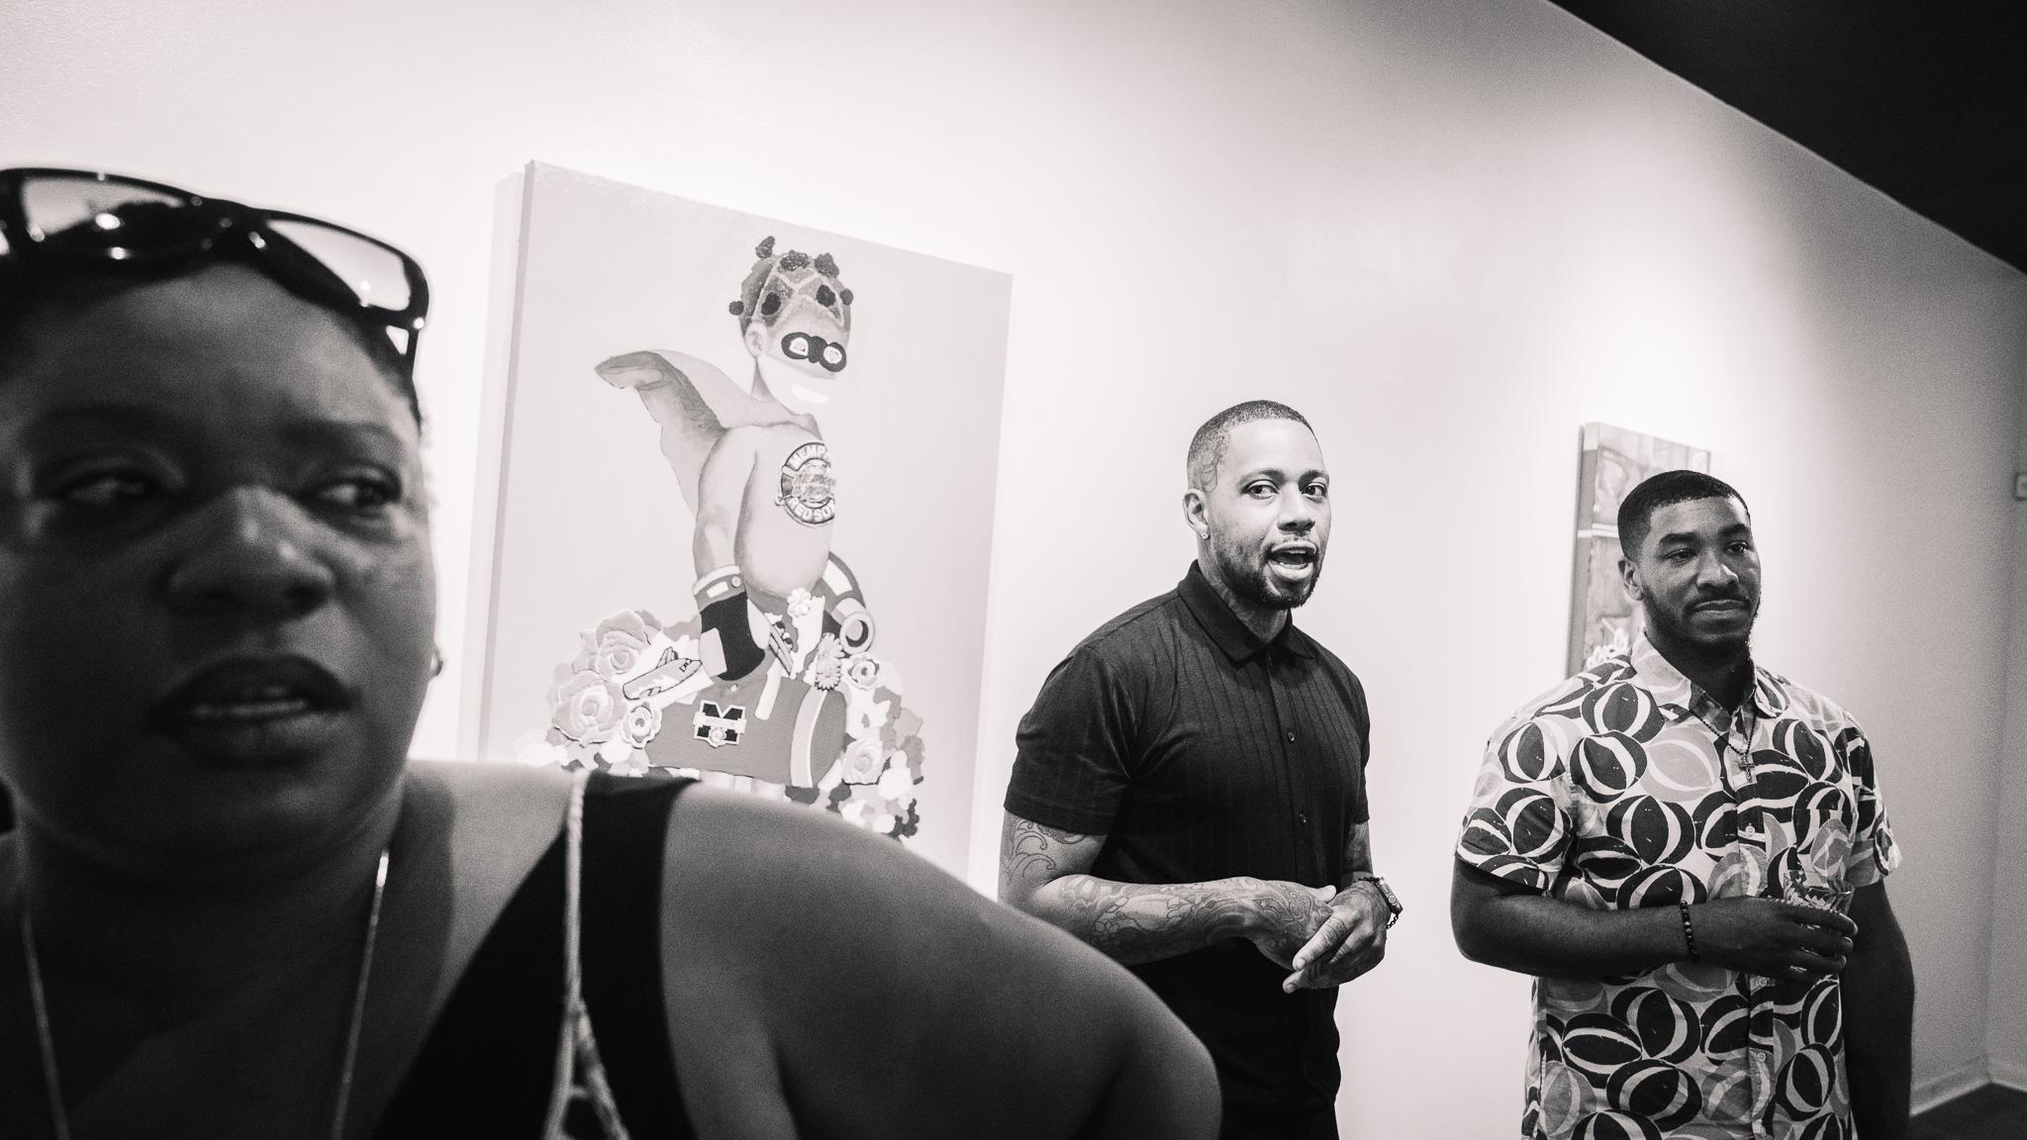
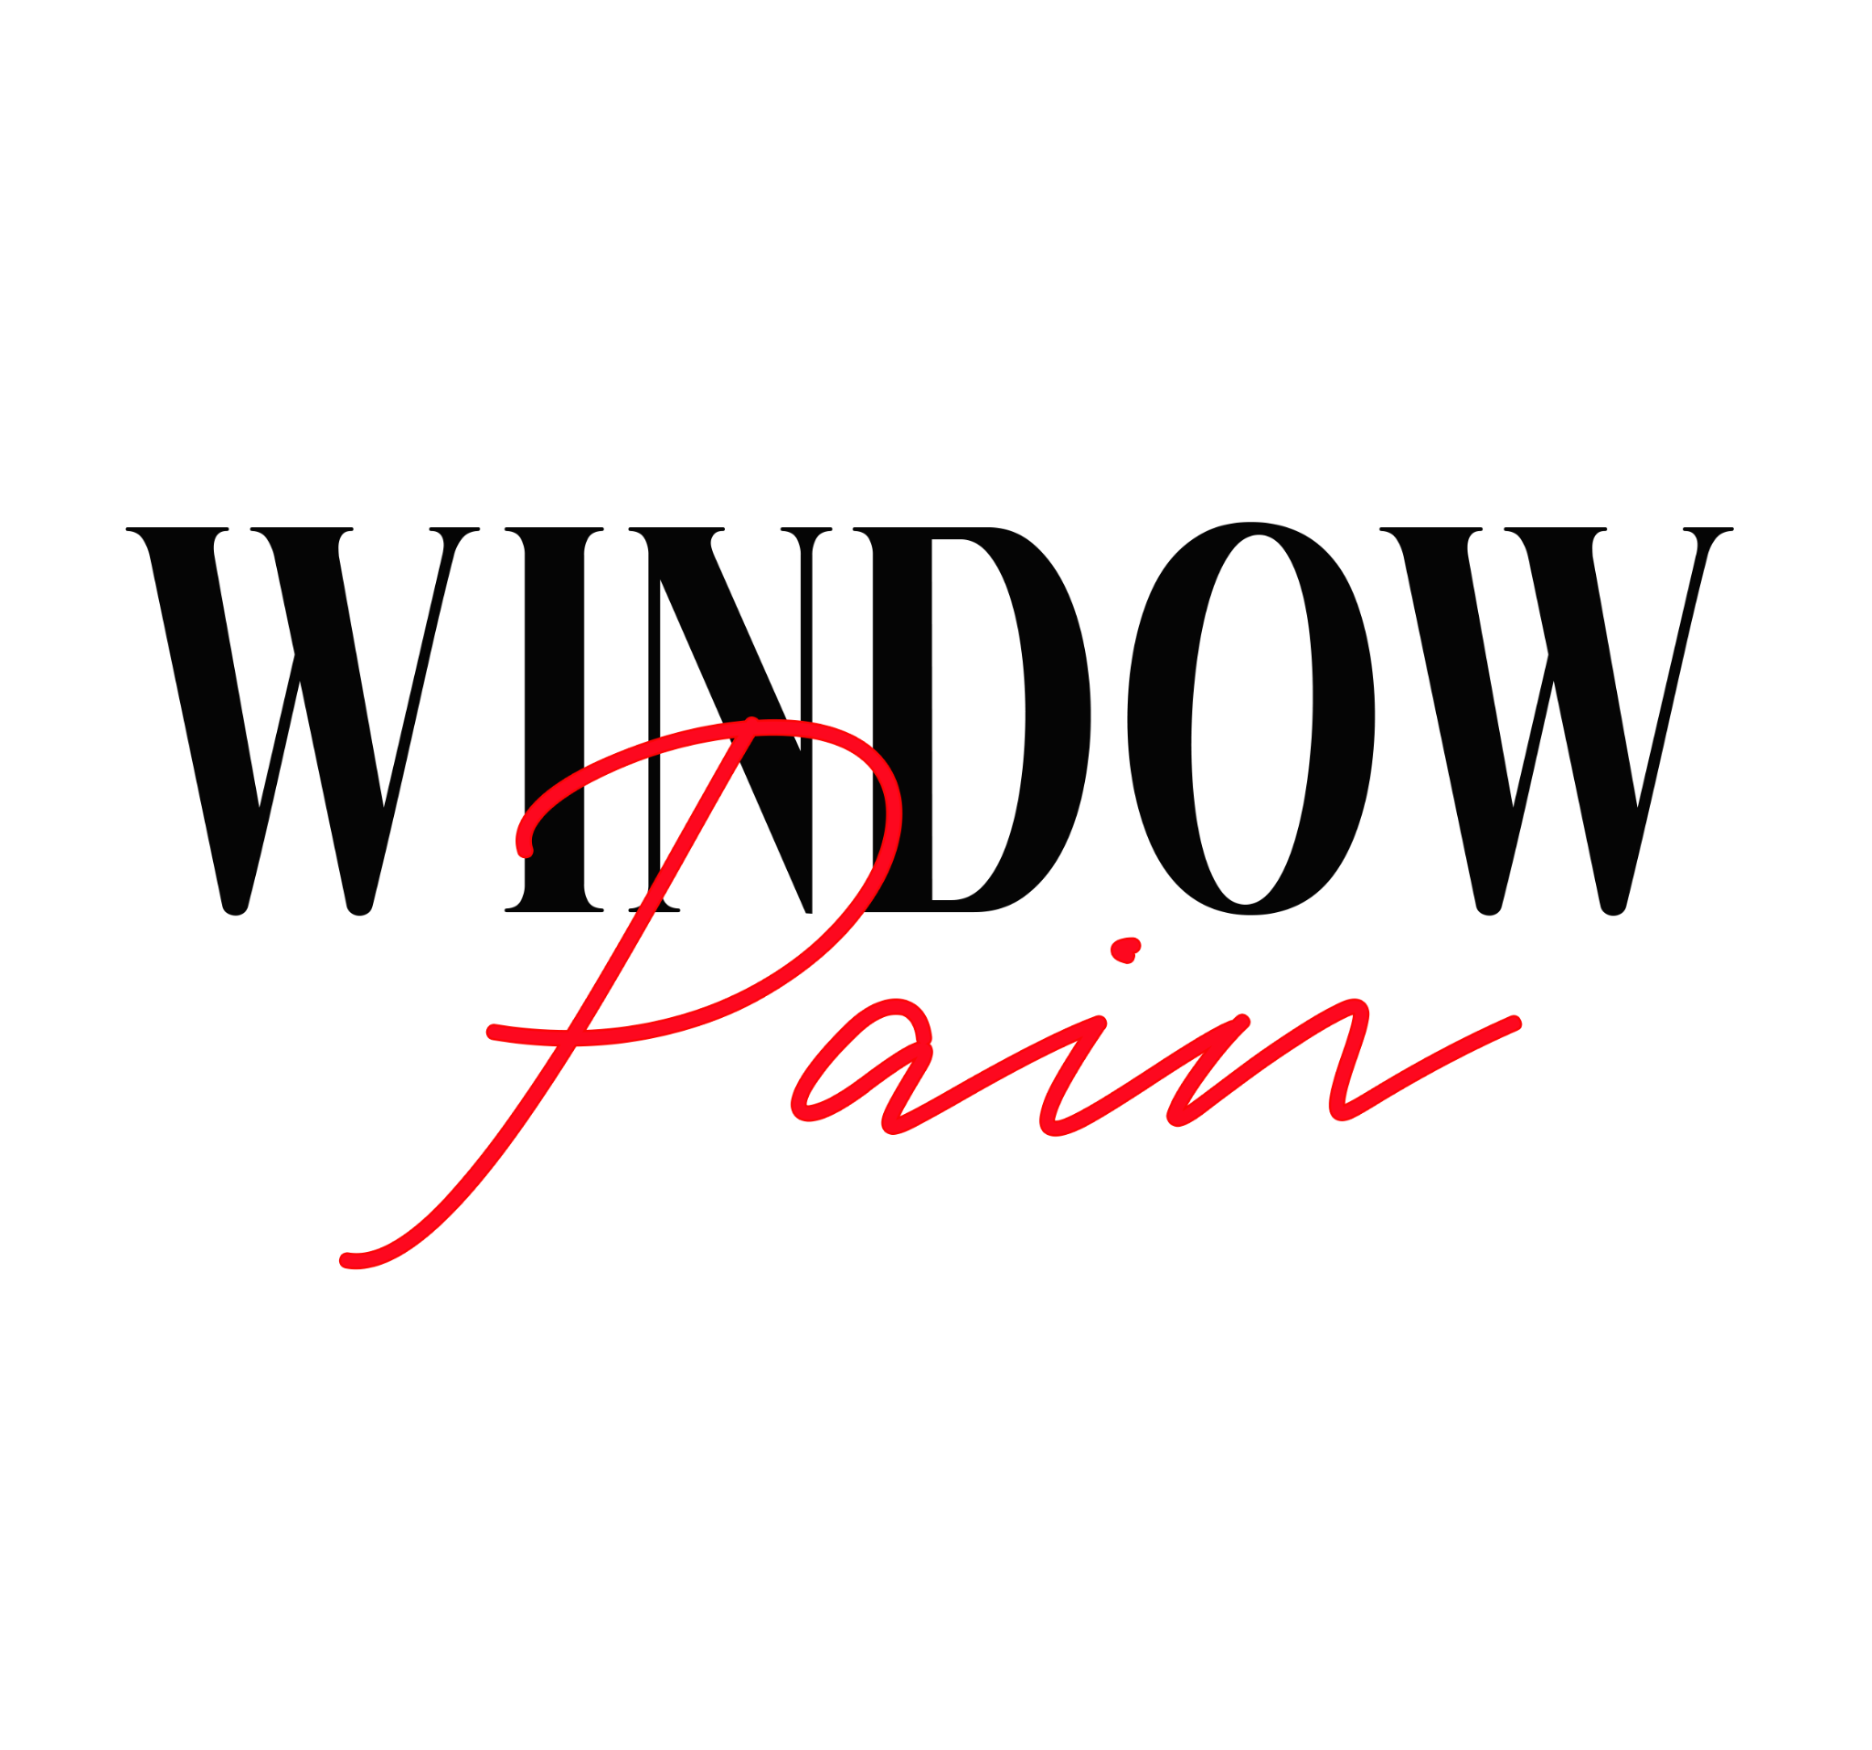
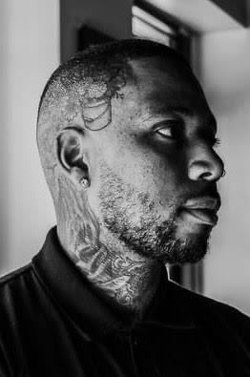
SOLO EXHIBITION

Slide 10
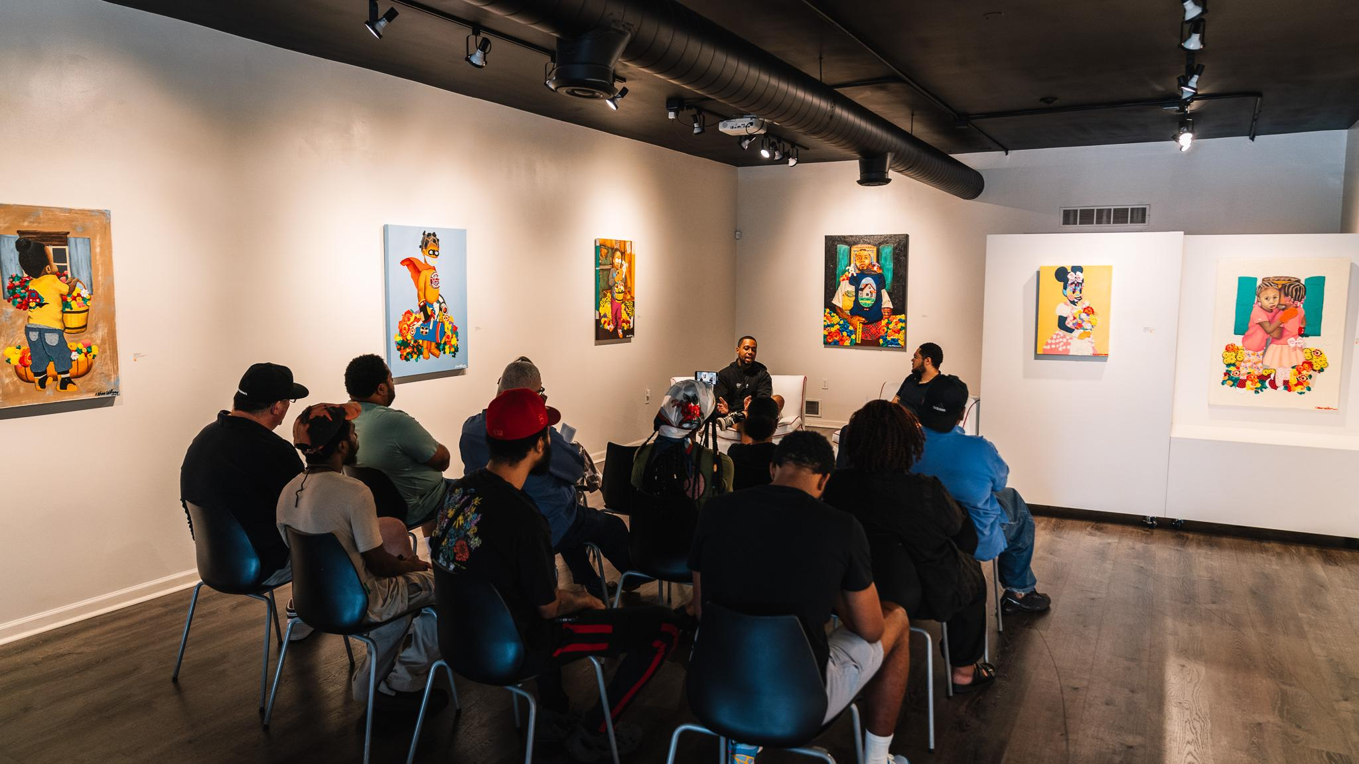
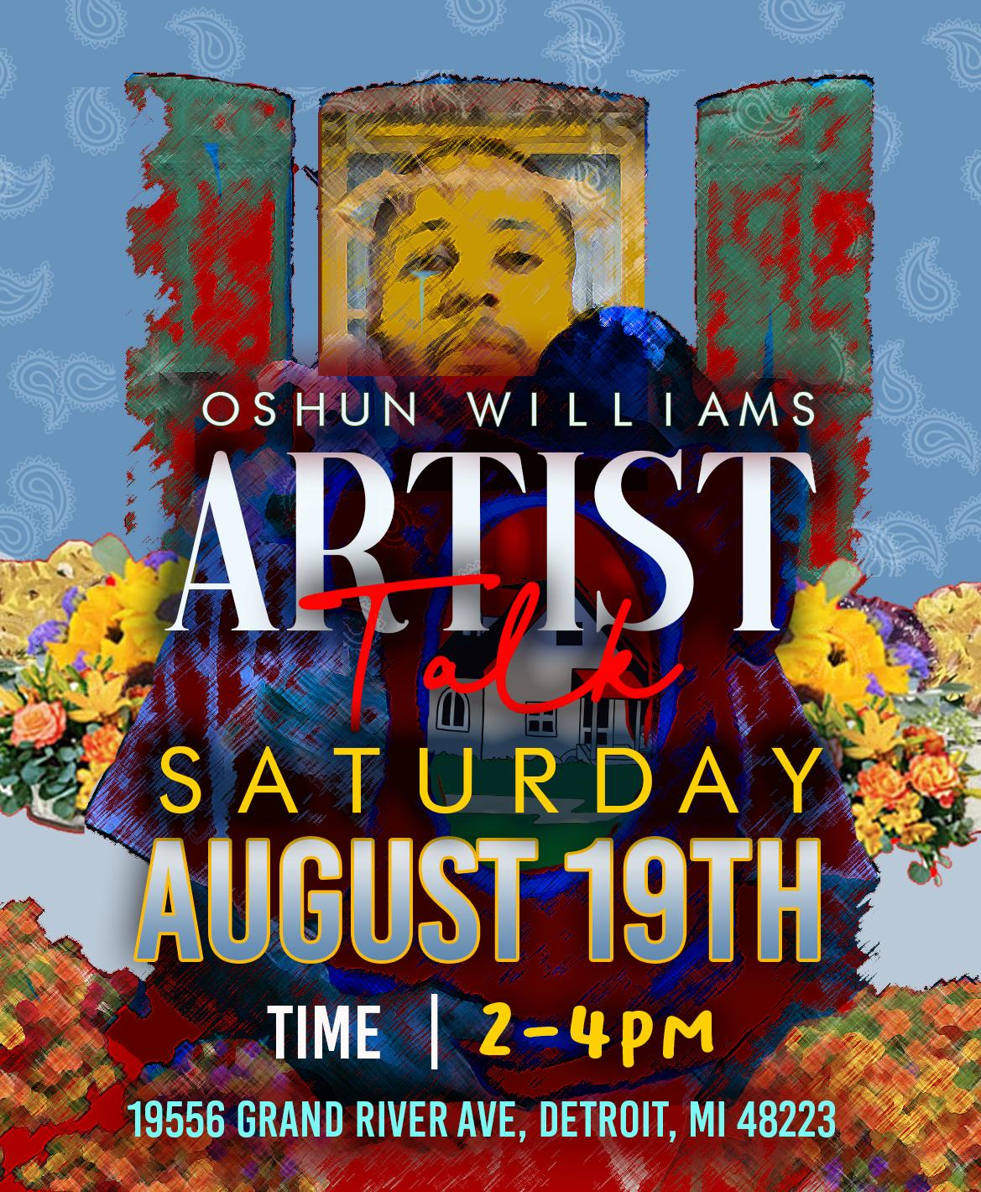

Slide 11
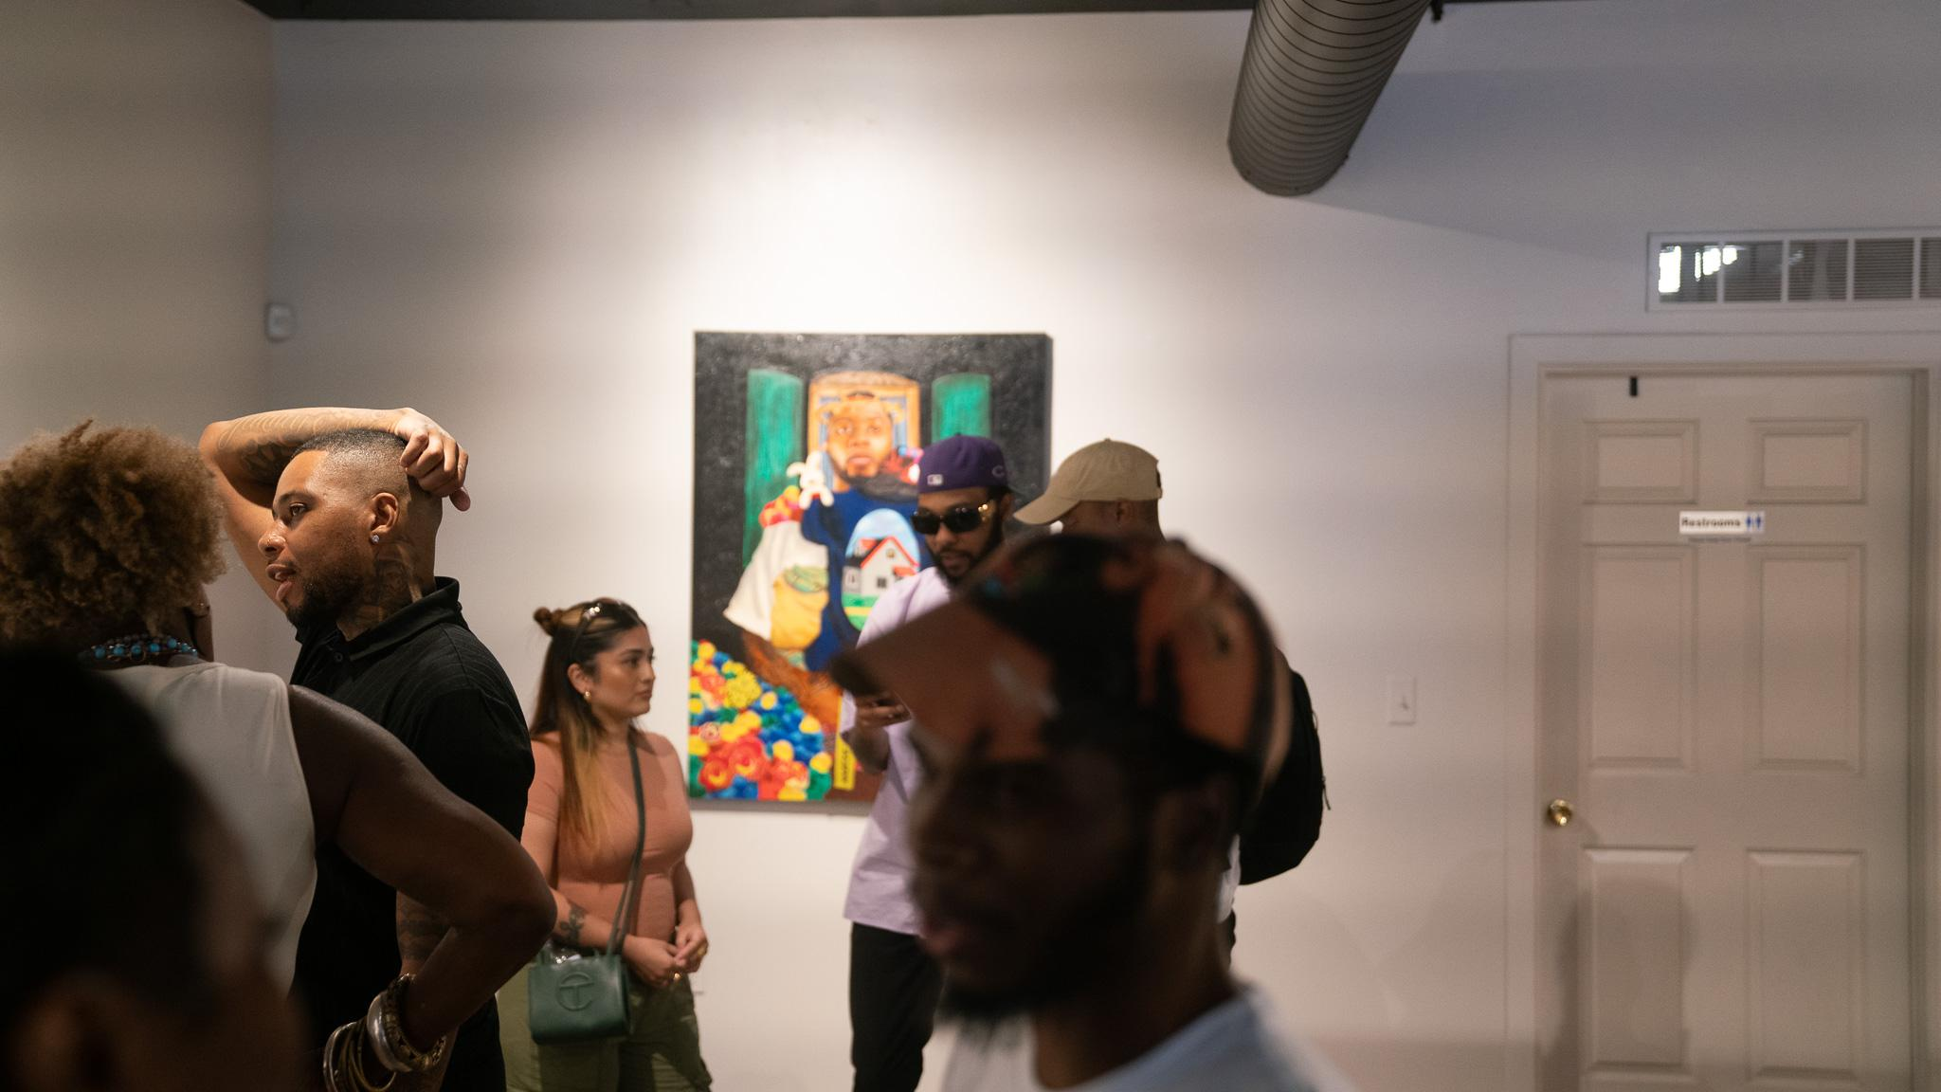
2nd SOLO Exhibition of 2023
Williams composes vibrant images to ratiocinate on healing through creative expressions.

Slide 12
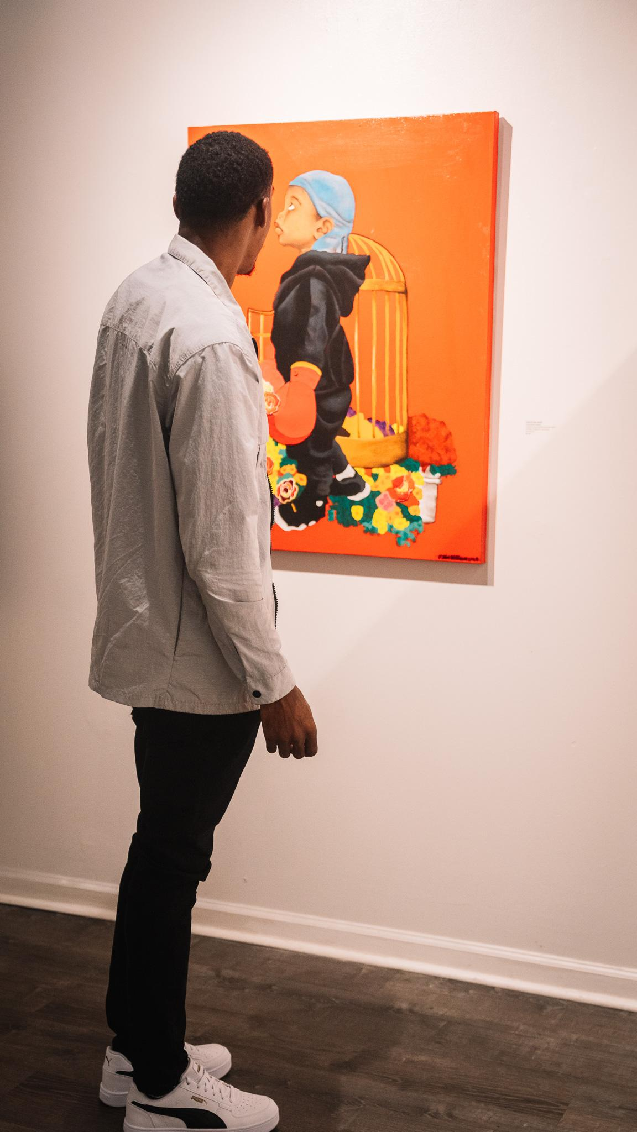
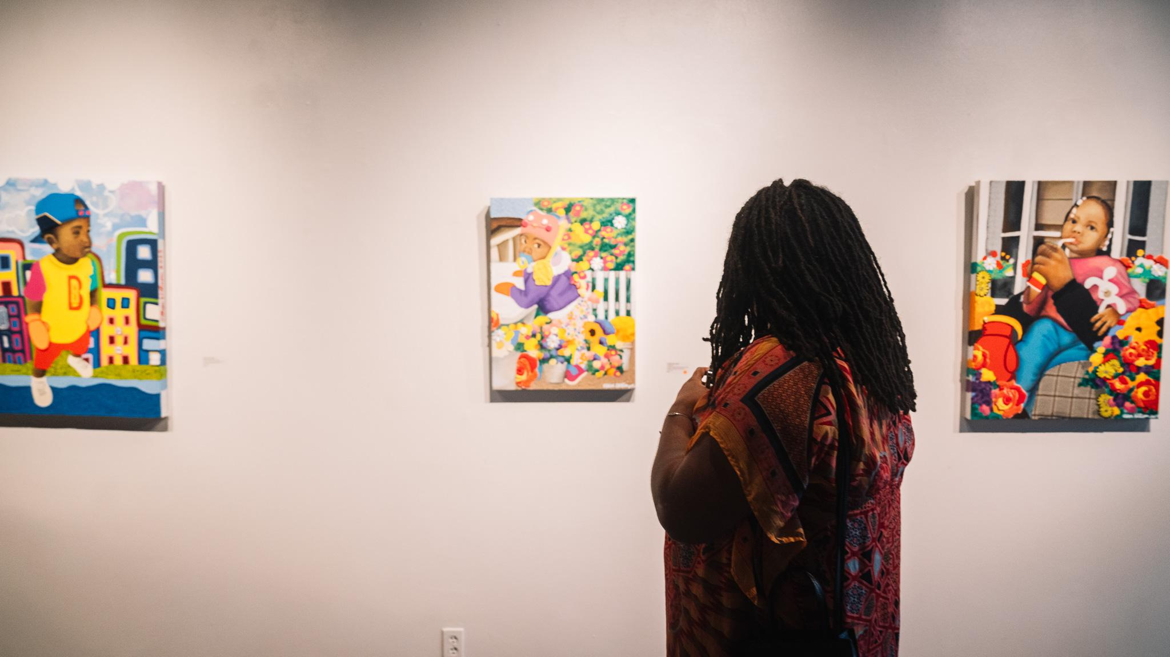
Emerging Artist, Oshun Williams, has been climbing tremendously through the Detroit art market with his innovative mixed media pieces.
2nd SOLO Exhibition of 2023

Slide 13
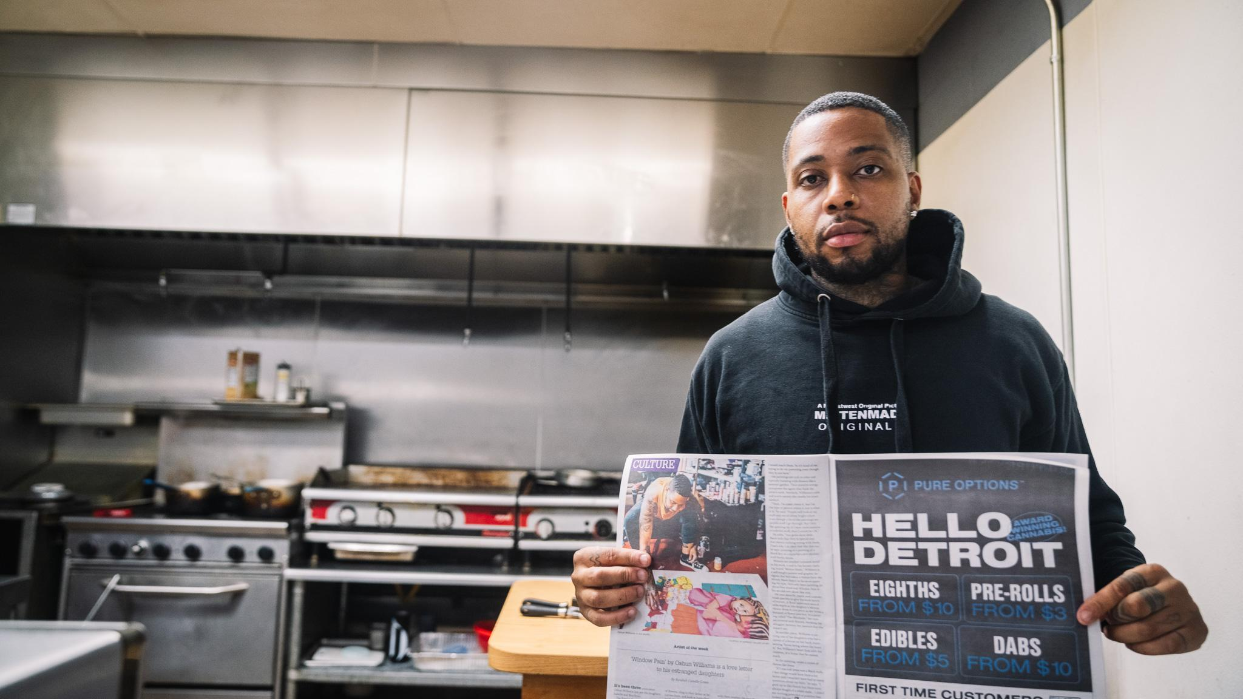
TIMES

Slide 14
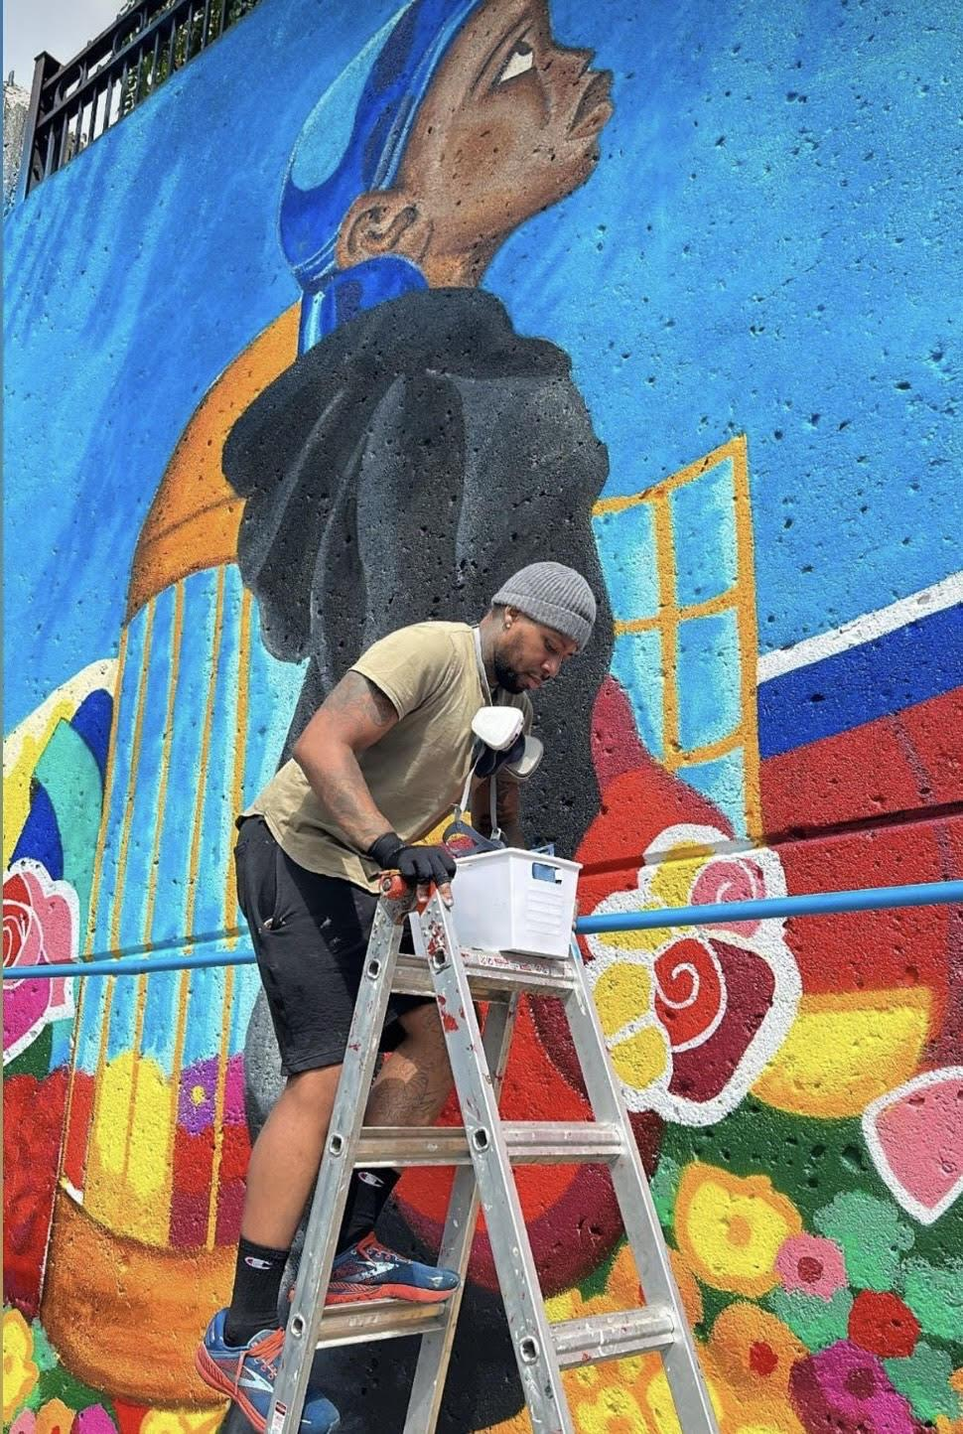
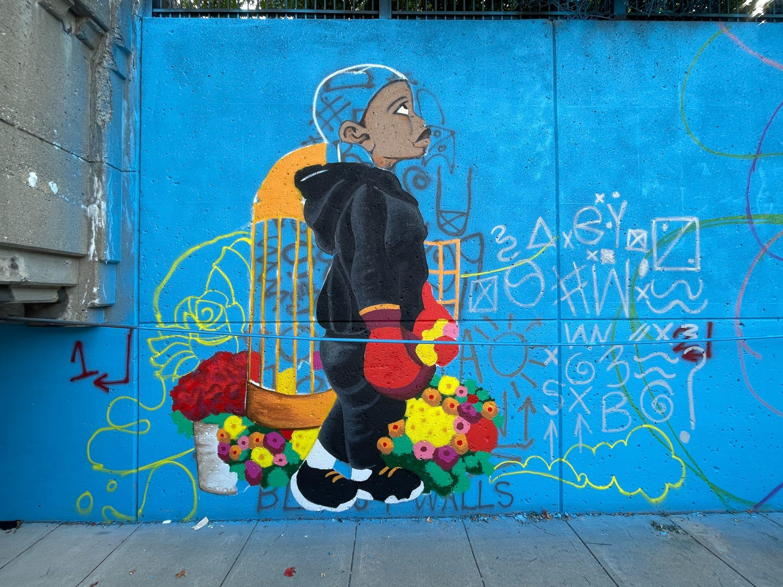
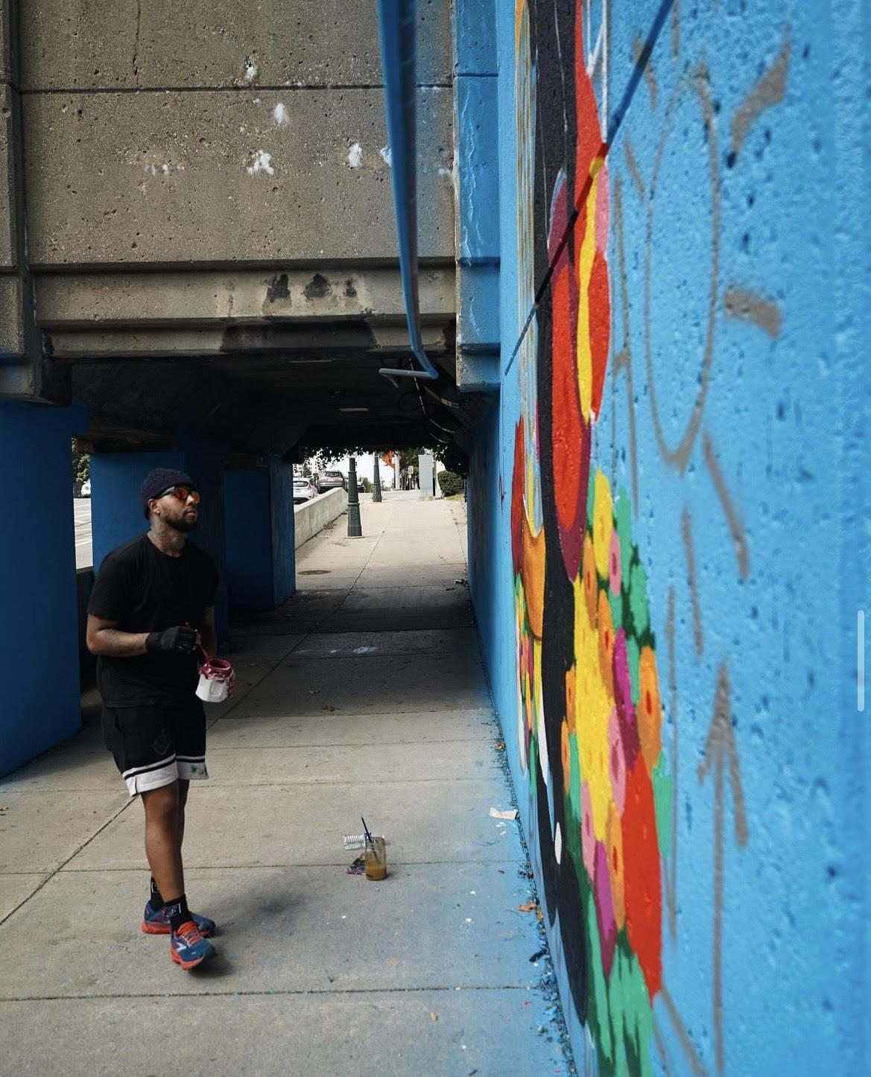
W A L L S
2023

Slide 15
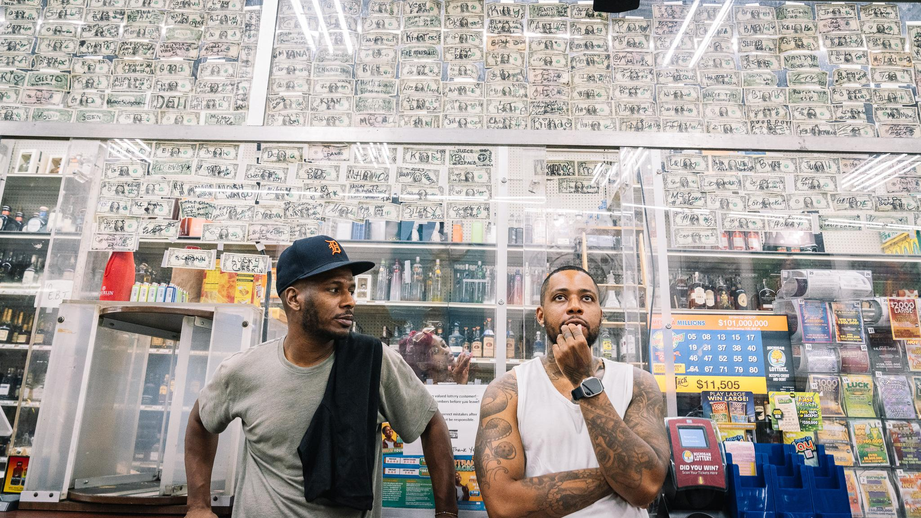
ANYTHING IS POSSIBLE

Slide 16
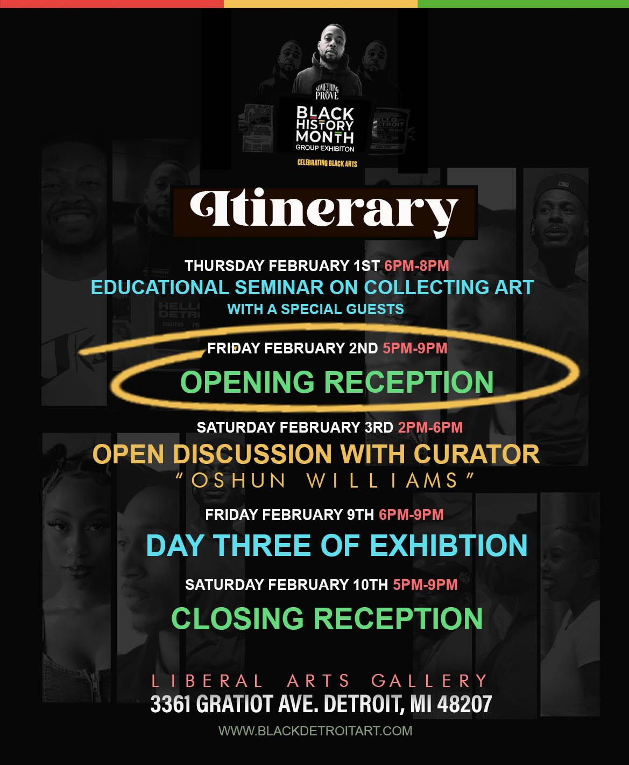

Slide 17
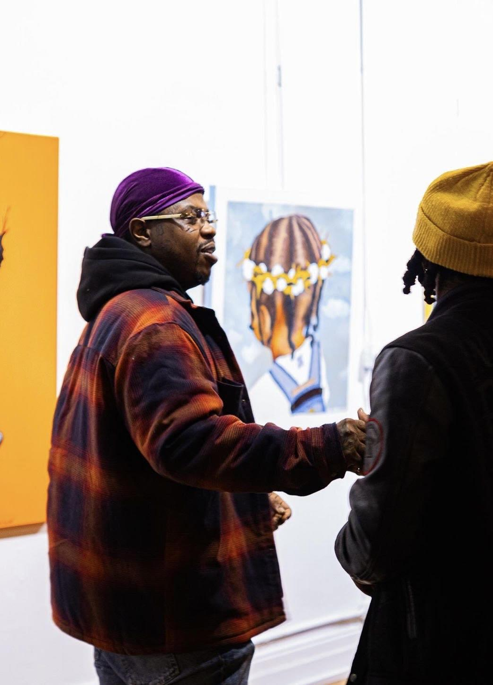
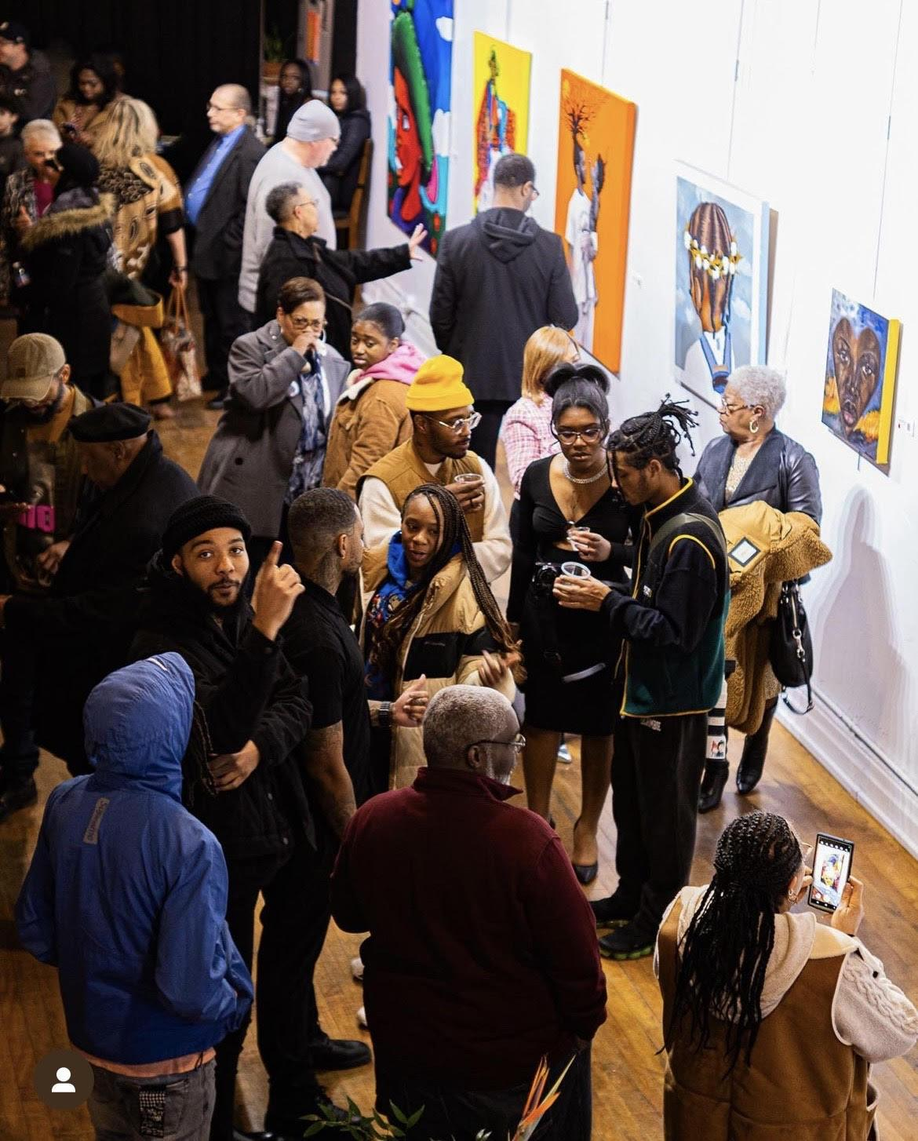
FEBRUARY 2024

Slide 18
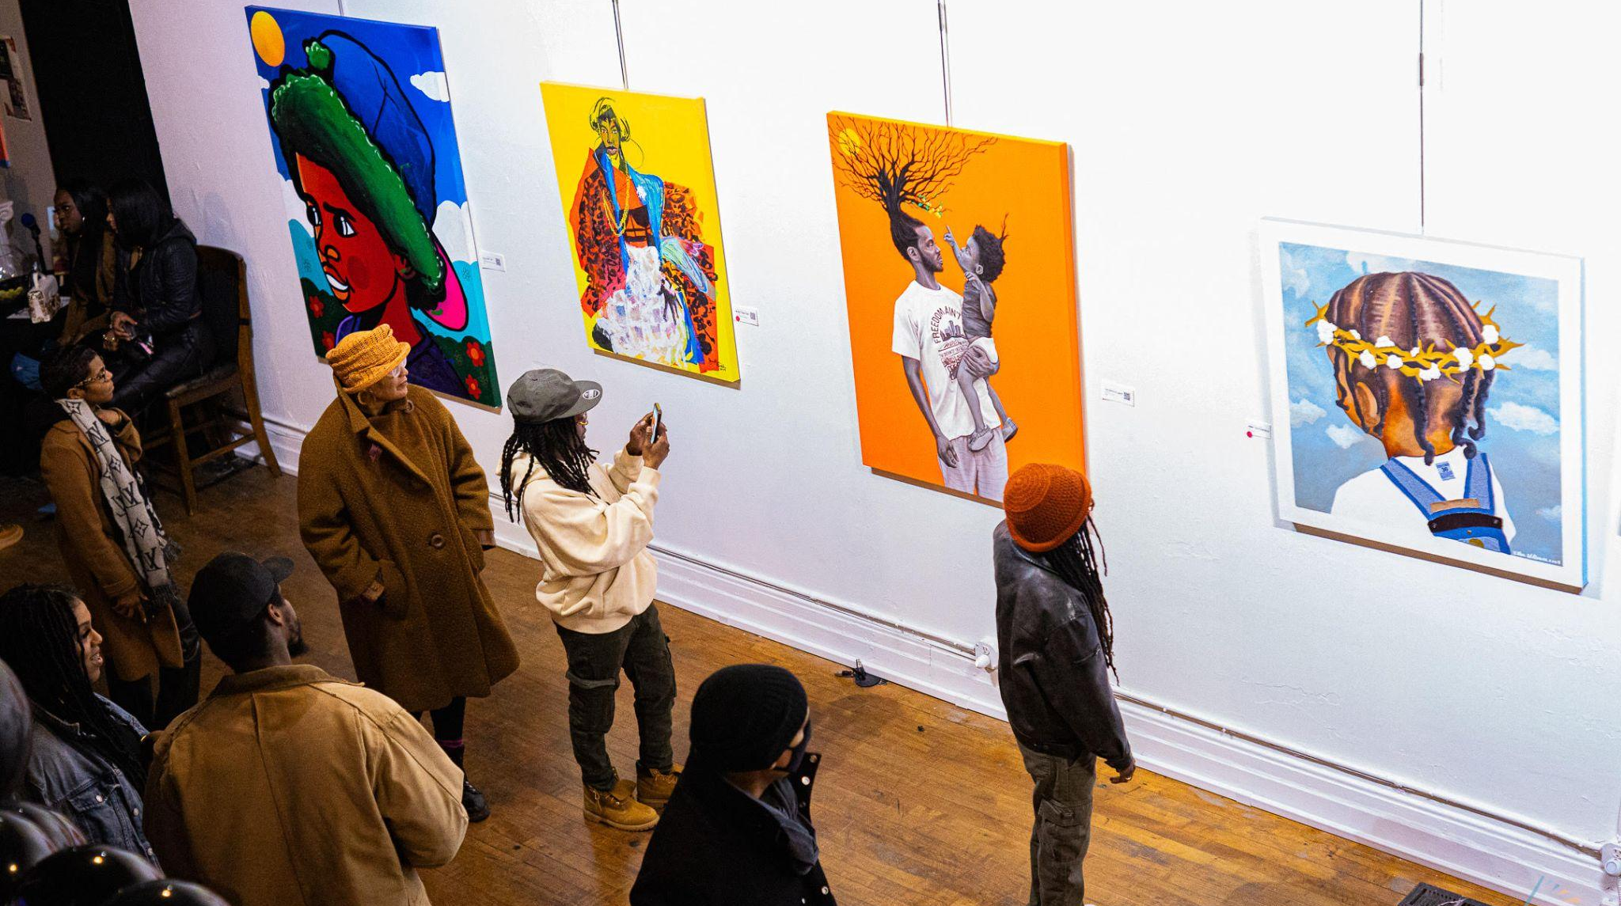
FEBRUARY 2024

Slide 19
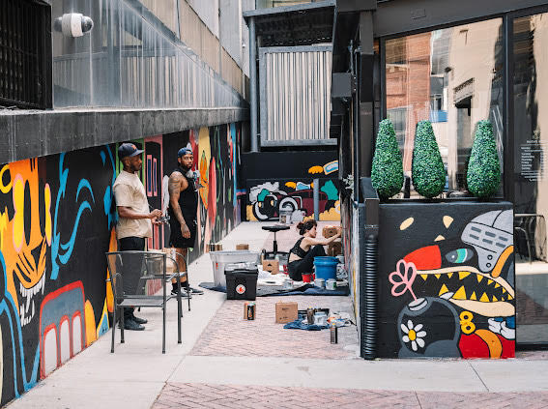
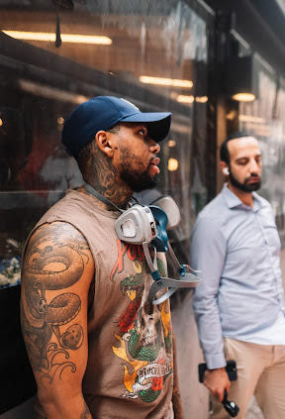
MURAL PROJECT
MAY 2024

Slide 20
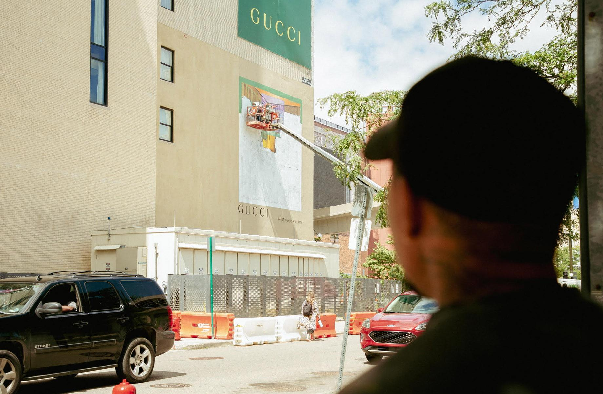
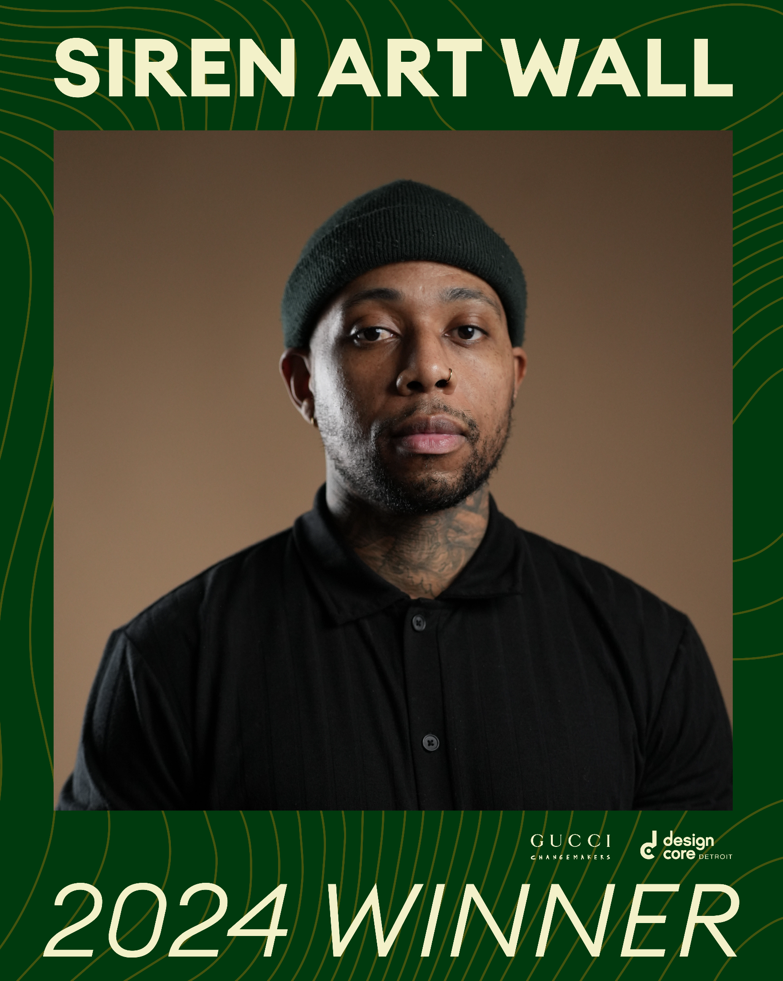
AUGUST 2024

Slide 21
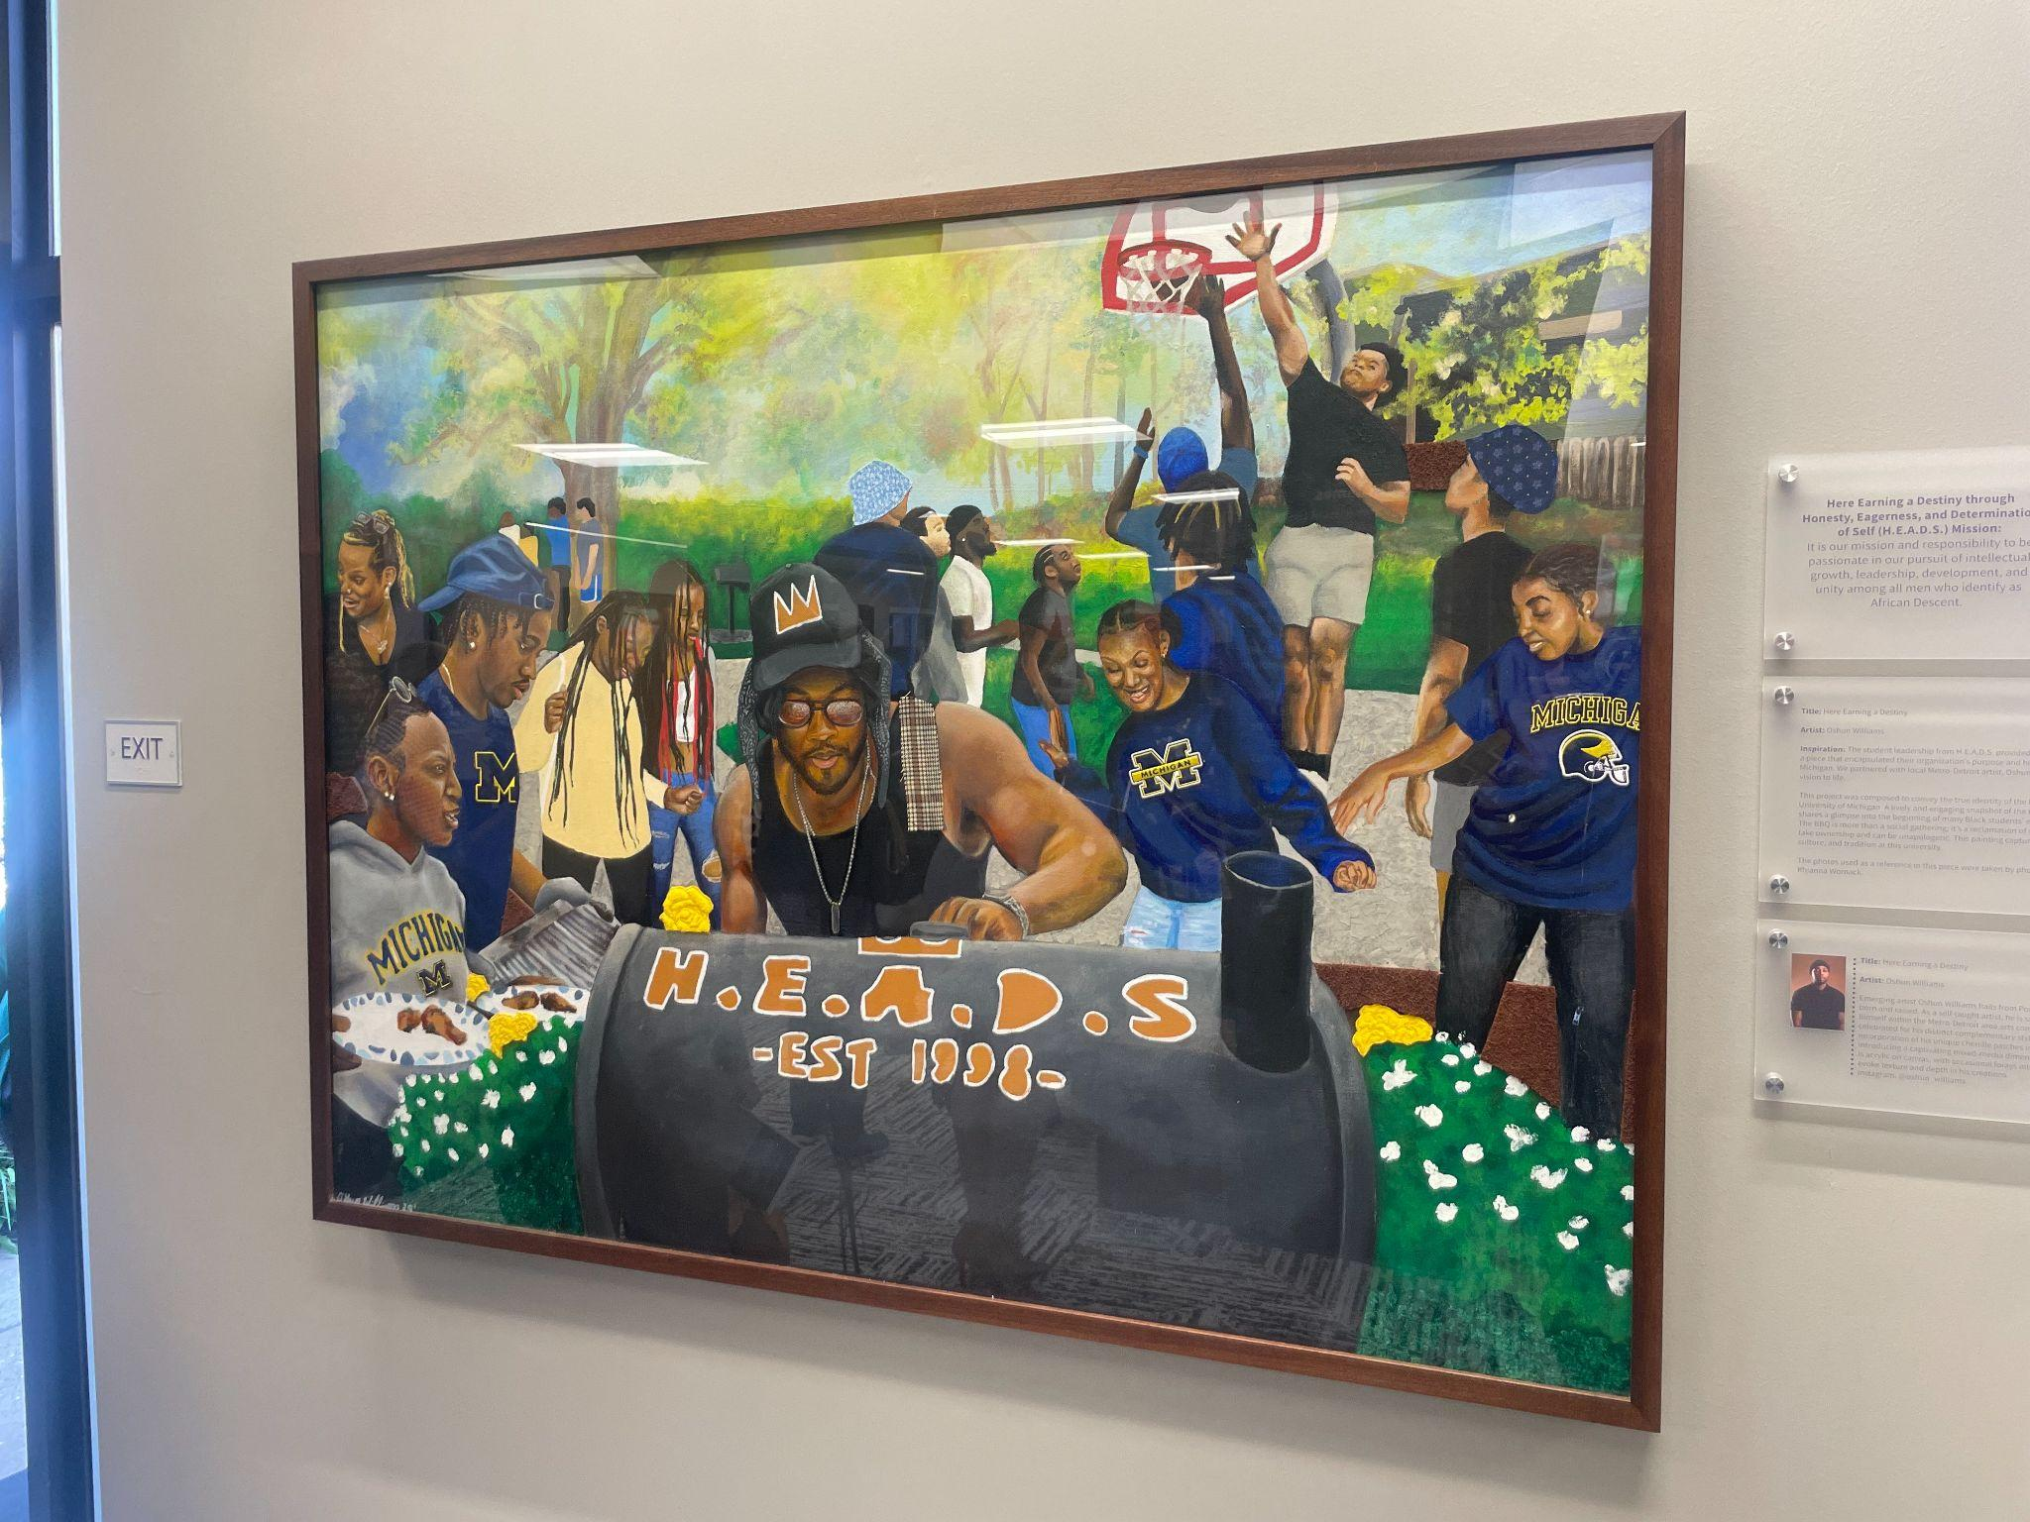
OCTOBER 2024
AUGUST 2024

